Slide 1
Welcome to Finstall First School New Parents’ Information
www.finstallfirst.co.uk

Slide 2
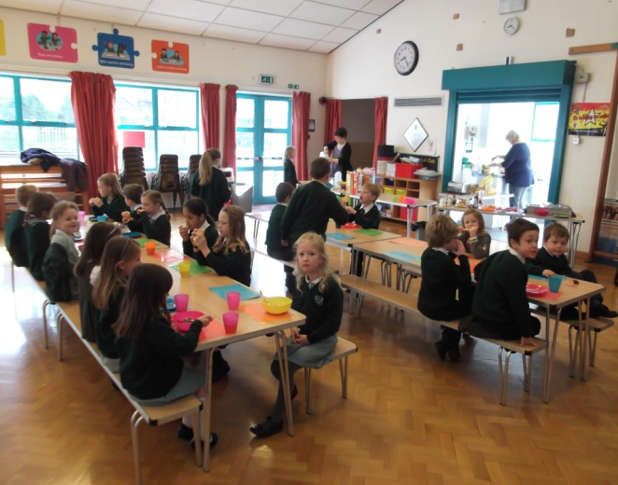
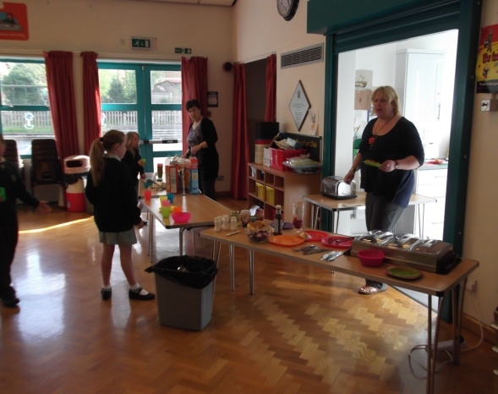
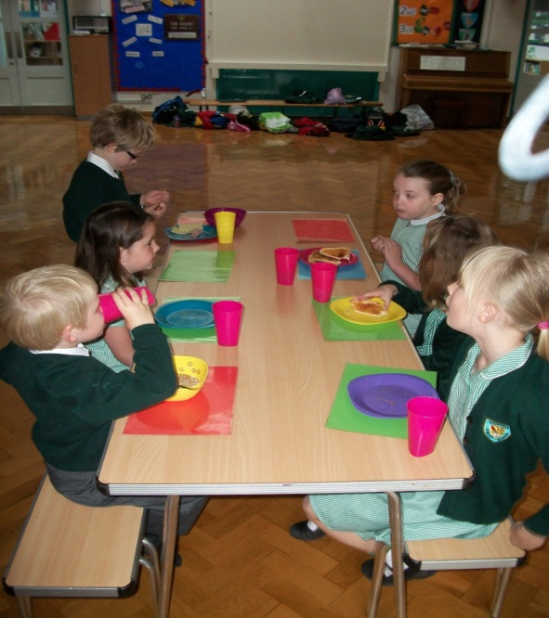
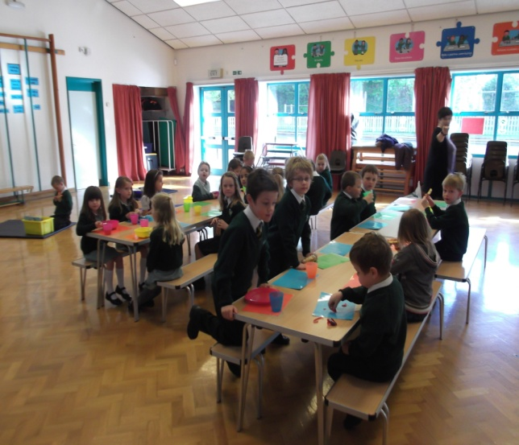
Breakfast Club Runs from 7.45am and we offer toast and cereal for breakfast. Please ask at the office for more information and about how to book.
Notes:
We recommend that children do not start Breakfast club until they have started full time in school.

Slide 3
School and routines
Morning bell = 8.50am – 9.00am - Children will enter the Reception classrooms as independently as possible. Please allow your child to come in on their own.
Snacks = Children have access to fruit throughout the morning at the Snack Bar.
They have a second snack and access to milk in the afternoon.
Lunch= 11.50am – Hot meals or sandwiches. Children are always closely monitored by lunch time supervisors. We will let you know if your child has not eaten much at lunch time.
Home time= 3.15pm – Children must be collected at the doors by the appropriate adult. If your child is being collected by someone different, it must be written in the communication book and passed on to the teachers.

Slide 4
Morning snacks
Please put it in the children’s book bags – it must be an actual recognisable piece of fruit / vegetable, not packets e.g. Yoyos, yoghurt raisins, cereal bars, etc.
Afternoon snacks
You may want to provide your child with a second piece of fruit/vegetable, or they can choose from our selection of fresh fruit.
Water bottles - Please do not put them in book bags, they can leak onto the school books.
Please make sure they are easily accessible to the children and are clearly named.

Slide 5
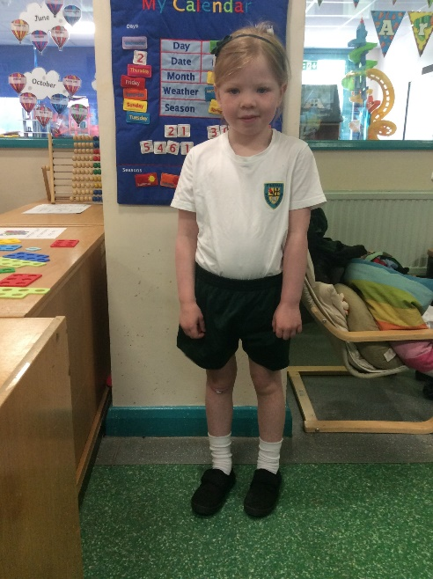
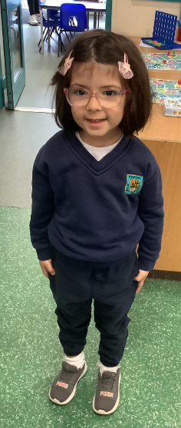
PE / Games – When is PE and what does my child need?
Indoor PE
Rabbits: Monday
Hedgehogs: Tuesday
Indoor PE kit
Please can children come to school wearing their PE kit on the day of indoor PE.
*White t-shirt
*Green shorts
*Navy sweat shirt and jogging bottoms in the winter
*Trainers
They will need to have a pair of plimsolls kept in a bag in School.
Outdoor Games
Rabbits and Hedgehogs: Thursday
Please can children come to school wearing their tracksuit and
trainers on Thursdays.
*White t-shirt
*Navy sweat shirt
*Navy jogging bottoms
*Trainers
*Shorts in the summer

Slide 6
Uniform – What to wear
Please label
everything
as clearly as possible.
Yes, even socks, shoes and gloves!
Start asking your child to get
themselves dressed/undressed and to try to fasten/unfasten their own buttons, zips and shoes.
Please encourage your child to independently put on and take off their jumpers and coats.

Slide 7
Parent / Teacher relationship
Communication books are used to pass on any information to the teachers, please keep these in your child’s book bag.
Put all letters or important information in the communication book tray, which will be placed outside the classroom daily.

Slide 8
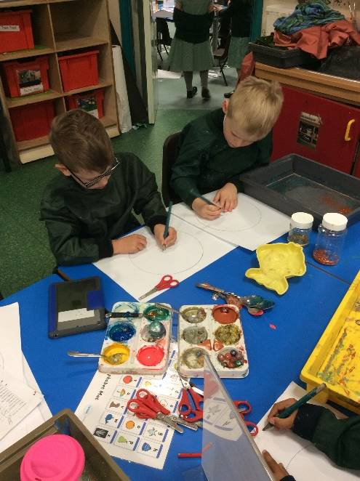
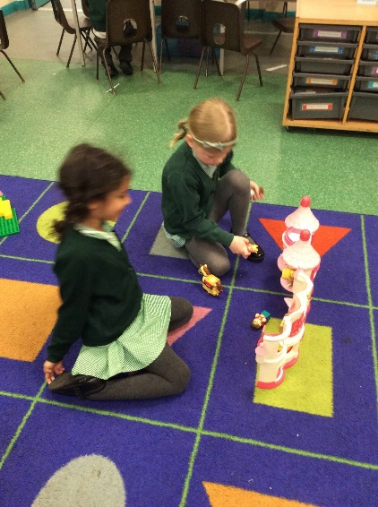
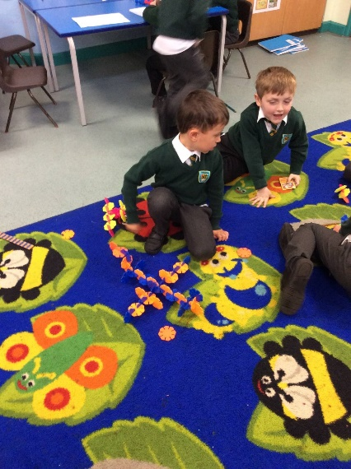
Structure of your child’s day The Early Years Foundation Stage Curriculum at Finstall First School aims to develop the unique child, providing care and support in a safe environment in order to give them the best possible start to their school life.
Fun and enjoyment!
Learning through organised play - both child and adult initiated activities
Opportunities to learn new vocabulary
Access to the indoor and outdoor areas
Carefully designed curriculum to support children to learn key knowledge and skills.
MorningsStarter activity / Register | Maths teaching | Continuous Provision / Focus activity / Snack | Phonics teaching | Lunch | Topic Teaching | Continuous provision / Focus activity Snack | Assembly Story Nursery rhymes Memory of the day | Home Time

Slide 9
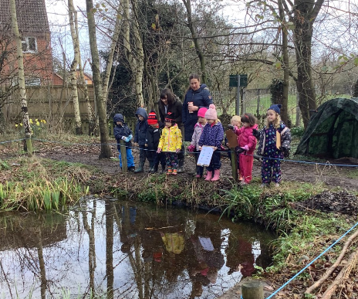
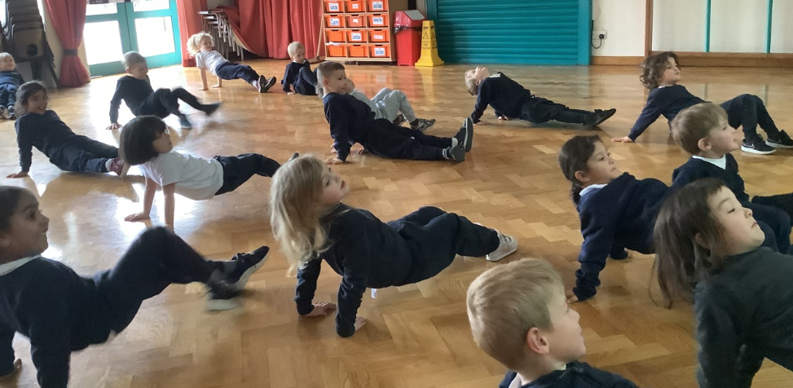
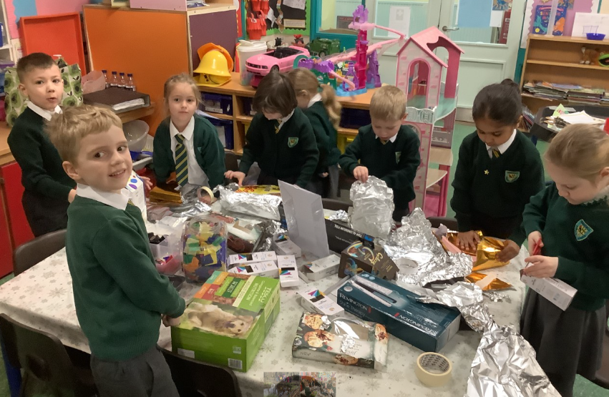
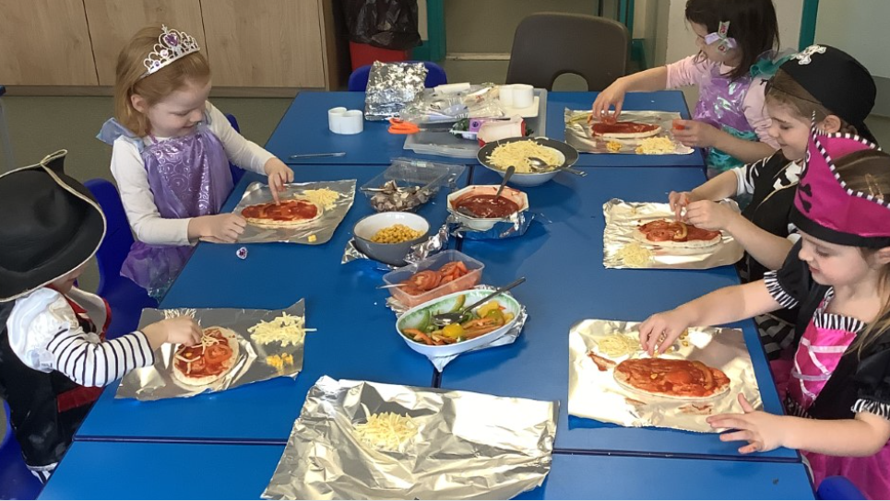
7 Areas of Learning
Personal, Social and Emotional Development
Communication and Language
Literacy
Mathematics
Understanding of the World
Physical Development
Expressive Arts and Design

Slide 10
How we assess in the Early Years Foundation Stage
Baseline assessment – within the first 3-4 weeks of your child starting school.
This helps determine what your child knows and can do.
We use this assessment to help us plan appropriate activities to challenge your child in their learning and to help them to make progress.
We continue to assess and observe the children to make sure learning is pitched appropriately.
We spend a lot of time talking to the children, encouraging two way conversations and speaking in full sentences.

Slide 11
How will I know how well my child is achieving?
We will hold baseline meetings within the first half term of your child starting school
Autumn Term 2- Informal Parents’ Evening
Spring Term 1- Formal Parents’ Evening
Summer Term – Written End of Year Report
At the end of Reception, for each Early Learning Goal, children will be given a best fit judgement of either:
Met or Not Met

Slide 12
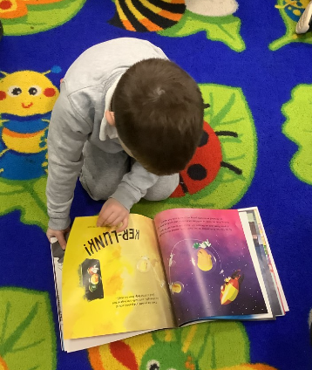
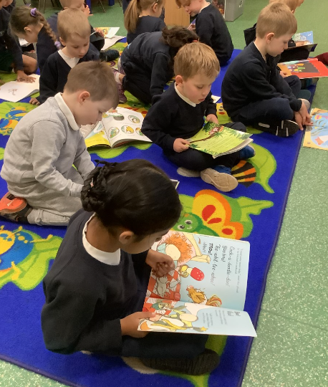
Reading
We will follow the Systematic Synthetic Phonics Programme, “Essential Letters and Sounds” and phonics will be taught on a daily basis.
Every Friday, your child will be sent home with two books, each book will be labelled with a sticker:
‘I read’ – a book your child should be able to read independently, practicing new sounds learned that week.
‘Read with me’ – a book to share. Your child may be able to read some of the words but may not have come across all of the sounds and may need your help.

Slide 13
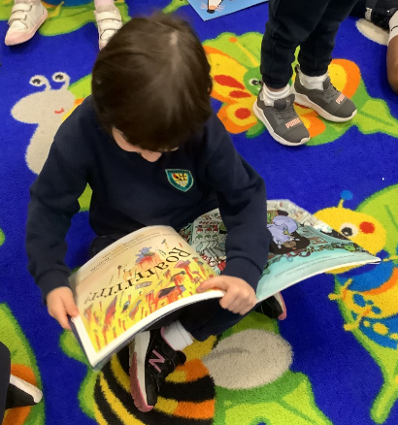
Reading Please encourage your child to read the ‘I read’ book four times within each week.
A key part of learning to read is that children re-read words and sentences that they can decode (sound out) until they are fluent (read with ease and precision). By reading the school reading book several times, children have the greatest opportunity to achieve this fluency.
Your child will be given a Reading Record. Please record every time that you hear your child read.
Each week, a member of the Reception team will hear your child read individually.

Slide 14
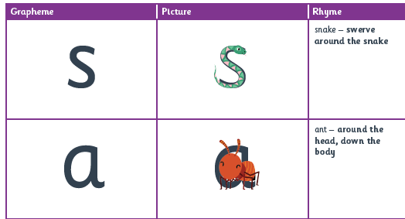
Handwriting
Through mnemonics and rhymes children are taught letter formation during our phonics lessons.
Please see the example in the book bags.

Slide 15
Forest School
Sessions will normally begin after October half term. You will receive further advice and information nearer the time.
Hedgehogs class – Tuesday Afternoon
Rabbits class- Friday Morning
On Hedgehogs’ Forest school day, children should come to school dressed in their outdoor clothes (e.g. tracksuit bottoms, long sleeved top) not their school uniform.
Children to bring spare clothes, waterproofs, wellies, hats, etc. in a separate bag and will be asked to change into it at the appropriate time.
On Rabbits’ Forest School day, children should come to school dressed in their outdoor clothes (e.g. tracksuit bottoms, long sleeved top), waterproofs and wellies, ready to go straight out to Forest School. They should not arrive in school uniform.
Children should always bring a bag with spare clothes, spare shoes, spare coat and a separate bag (for dirty wellies and clothes).

Slide 16
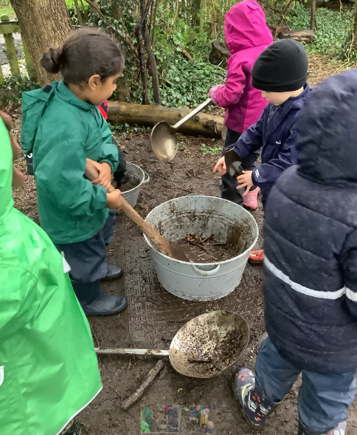
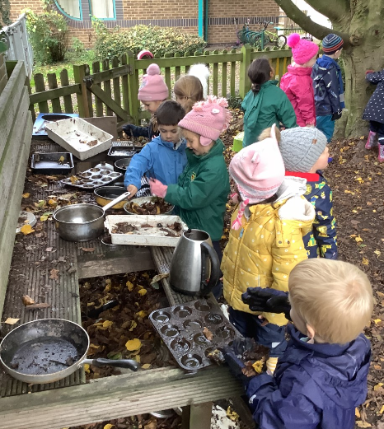
Forest School
Ethos/Definition
“Forest School is an inspirational process that offers ALL learners regular opportunities to achieve,
develop confidence and self-esteem through hands-on learning experiences in a woodland or a natural environment with trees.”

Slide 17
What does my child need to wear?
Winter
Warm clothing as we go out in all weathers!
Socks
Wellies
Trousers (tucked inside wellies)
Jumper
Hat
Scarf/gloves (Thinsulate mittens )
Waterproofs (ideally separate trousers and jacket)
Summer
Even if it is warm, children need to wear clothing that covers their legs and arms to protect against nettles and branches.
Plastic bag for dirty clothes and wellies
Spare set of clothes as we often get messy!

Slide 18
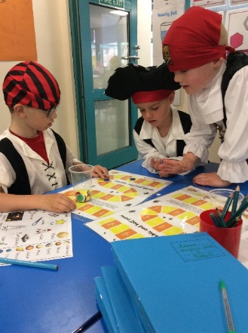
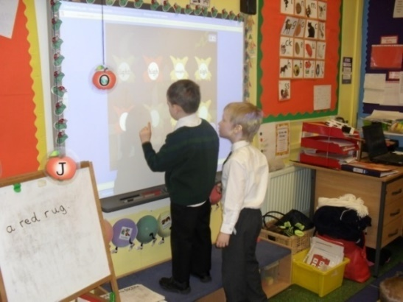
Induction Days
Your child will be in either Rabbits or Hedgehogs class.
The children have been split into two groups: Group 1 and Group 2.
All children are invited to attend a one-hour morning session on either Wednesday 28th June (Group 1) or Wednesday 5th July (Group 2) between 9.00am-10am.
We will use this time to get to know your child, show them around the classroom and share some songs and stories.
Please see the induction letter in your child’s book bags which confirms the days and times we would like your child to attend.

Slide 19
Induction Day Monday 17th July 2023
Group 1 – Morning
Group 2 - Afternoon

Slide 20
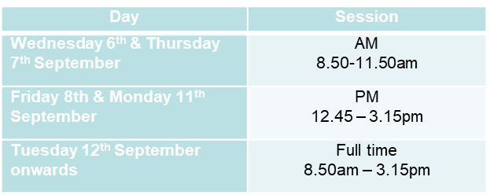
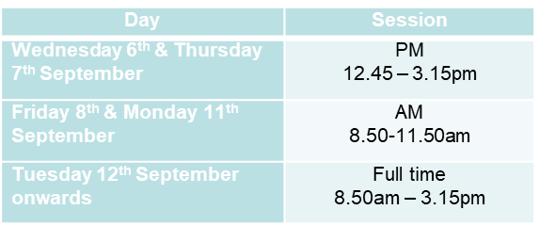
FINSTALL FIRST SCHOOL
THE INDUCTION PROCESS
Your child will initially start in September with a 4-day induction process. This allows your child to have a really worthwhile settling-in period, the chance to make some strong friendships, learn the rules and routines and allow the Reception team to learn what your child can do and where to go next.
They will be split into two induction groups: Group 1 and Group 2.
Group 1 Group 2

Slide 21
Your Pack
Please take the time to read through the information that we have provided inside your child’s bookbag.
Please return the relevant forms to the school office as soon as possible.
Please make sure that the office staff have seen your child’s birth certificate this evening.

Slide 22
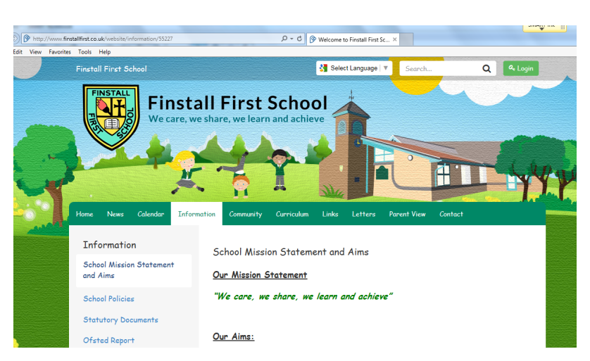
You can find this PowerPoint on the Finstall website.
www.finstallfirst.co.uk

