Slide 1
World War 2
By Penny and Owen

Slide 2
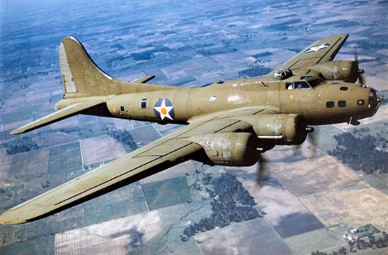
Planes
Planes were used for bombing cities. German planes only bombed big cities like London because they wanted to cause massive destruction.

Slide 3
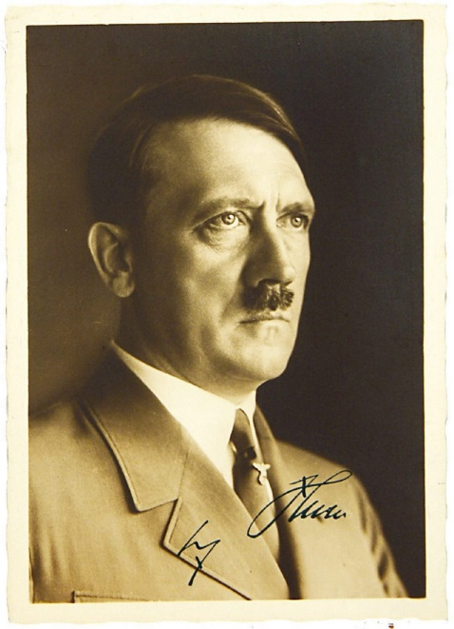
Adolf Hitler
Adolf Hitler was a mean man who led Germany. Hitler made Jews wear a star, this was so if anyone saw someone with a star then they would kill them.

Slide 4
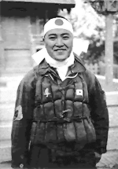
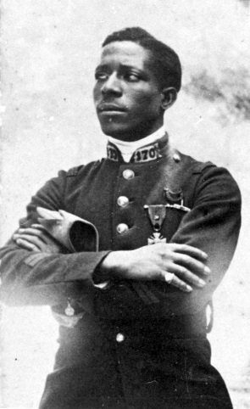
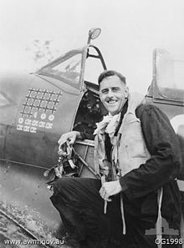
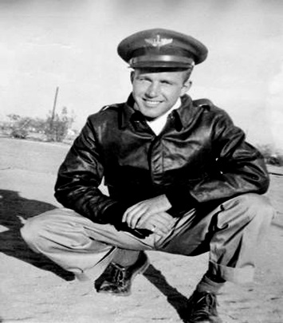
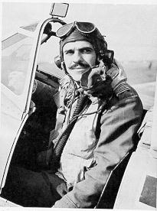
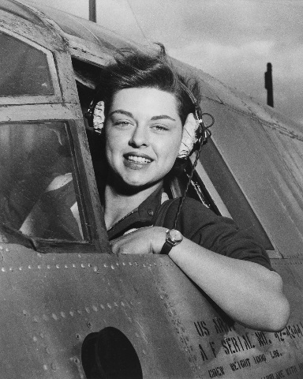
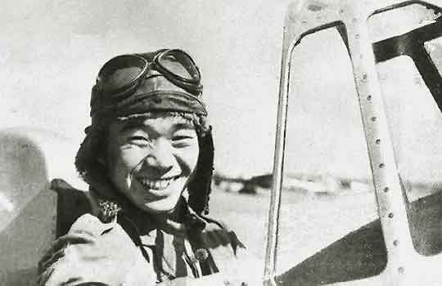
Pilots
Pilots in ww2 had be very clever and brave to fight in the war.

Slide 5
Footage of World War 2 bombing
https://www.youtube.com/watch?v=aeDvY4s7KDc
Click the link to watch the footage of planes bombing.

Slide 6
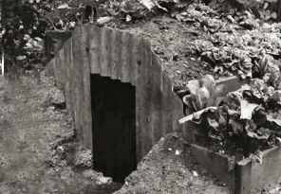
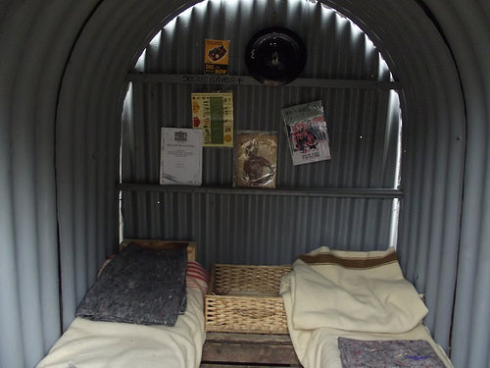
Anderson Shelter
Anderson Shelters were made out of metal and covered in soil, food such as cabbage and tomatoes, flowers or plants.

