Slide 1
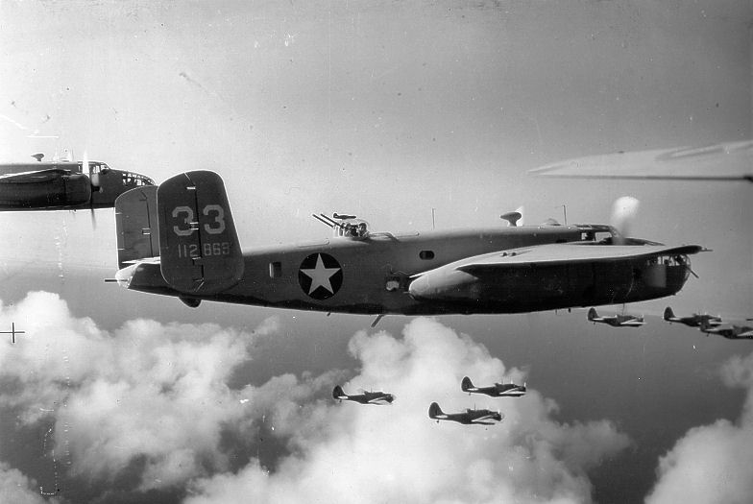
World War 2
World War 2
Presented by Amelia and Sophia-Mae

Slide 2
Winston Churchill
He is best known for standing up to the Germans in World War 2.He was also prime minister of Great Britain.
Winston Churchill was born on the 30th of November 1874.

Slide 3
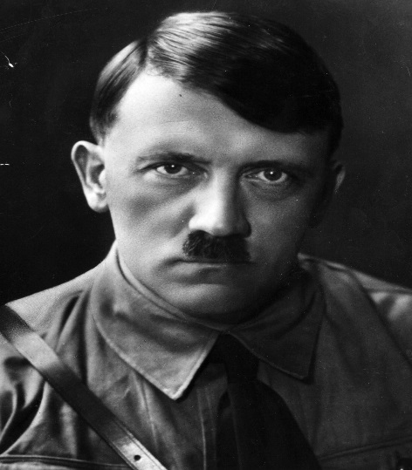
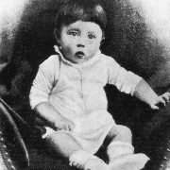
Adolf Hitler
Adolf HITLER WAS BORN APRIL 20TH 1889.HE WAS BEST KNOWN FOR STARRING WW2 AND THE HOLOCAUST.HE WAS THE DICTATOR Of Germany. He died the 24th of January 1965.

Slide 4
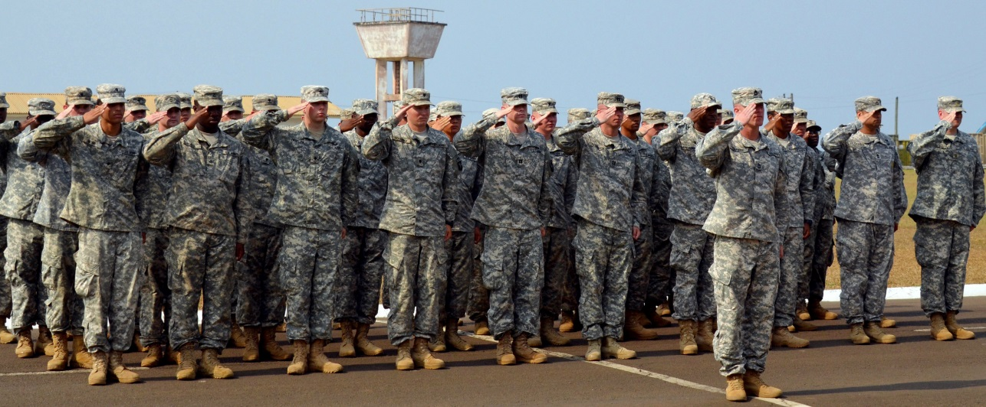
soldiers
In WW2,soldiers would carry a lot of Kit. They would carry:
Weapons (Rifle or Guns)
Their mess tin (food tin)
Personal hygiene
Tent and blankets
Reading and writing
Winter clothing
Cartridge box
Canteen
Eating utensils
Pipe and tobacco

