Slide 1
JOURNEY ON THE TRAIN
PRESENTED BY EVIE.HINTON AND AMELIA MARSON

Slide 2
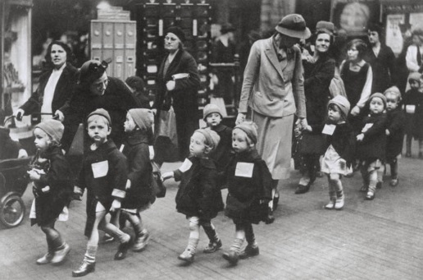
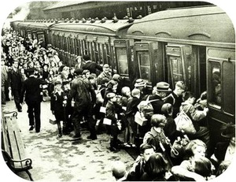
EVACUEES
THE CHILDREN GOT EVACUATED TO THE COUNTRYSIDE BECAUSE GERMANY THOUGHT THEY WOULD KILL MORE PEOPLE IN THE CITY THAN THE COUNTRYSIDE.

Slide 3
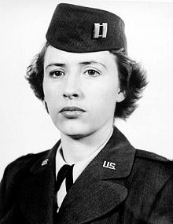
TEACHERS
The teachers had to go with the evacuees on the train so they can still be educated in the countryside.
Click here for video.

Slide 4
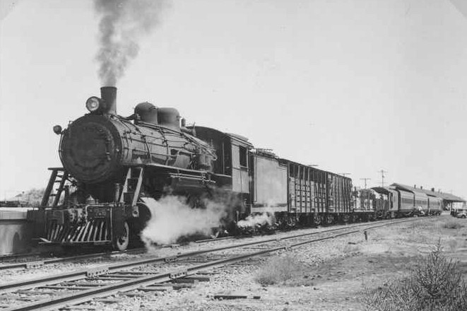
Trains in ww2
There are many different trains that carry evacuated children . Here is a steam train. Many children were evacuated on the trains to the countryside.

Slide 5
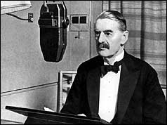
Before evacuation happened
.Nevil Chamberlin told everybody about war.
Here is his speech!
Nevil was the prime minister of England and he declared war on GE
War on Germany it wasn’t the other way around.
Click for speech

