Slide 1


IMPROVING Your Child’s Writing
- an information evening for parents.

Slide 2
Aims:
to give parents a greater understanding of how to help their children to improve their writing
to explain some of the techniques and strategies used in school

Slide 3


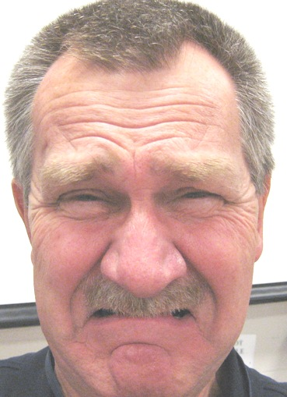

How Do You Feel About Writing?
Is this you?
Why?
Notes:
Why? lack of support at school its boring – where did this idea stem from?????
lack of praise
not many chances

Slide 4

Or is this you?

Slide 5
Writing
Writing is an amazingly complex activity.
The writer has to deal with many skills -
thinking what to write about
selecting appropriate content, supporting information and detail
linking it all together
layout of the text
grammar
spelling / punctuation / letter formation

Slide 6
Elements of Writing
Spelling
Punctuation
Handwriting
Composition
Notes:
There are 4 elements to writing and children have to learn how to do all of them.
In class we practice all of the elements in every lit lesson – we always tell the childen to check their spelling, mind their punctuation etc.

Slide 7
Becoming readers and writers
Before children can learn to read and write they need to develop their understanding of the English language. For all of us this happens through talk.
Through talk we learn new vocabulary and the knowledge of how to structure sentences.
In school we encourage the children to talk in a variety of situations.

Slide 8



Sounds~Write
We focus on pure sounds not letter names.
For example:
e is sounded as ‘eh’ not ‘eee’
f is sounded as ‘ffff’ not ‘eff’
Once the children are happy using the sounds they can begin to build words within their reading and writing.

Slide 9
What can you do at home?
Use letter sounds and not letter names
Write in lower case letters
Encourage your child to recognise letters in their environment; street names, signs, packets, brand labels.

Slide 10
In early Key Stage One, we encourage the children to say the sounds in the word they would like to write and then we support them with writing the letters. Once we can write words, we then move onto sentences.
In later Key Stage 1 and in Key Stage Two we develop these skills further by making sentences more complex. We support the children with developing their vocabulary choices and how to adapt their sentences to suit different purposes.
Writing

Slide 12
Writing
What can you do to help?
Encourage and praise all effort when writing
When talking with your child introduce new vocabulary and use it within context.
Read stories to your child and explain new words which you come across,
For children who are developing their writing style:
Once the children can write words we then focus on developing the vocabulary, introducing different connectives and openers and how to use punctuation. This is called VCOP.

Slide 13
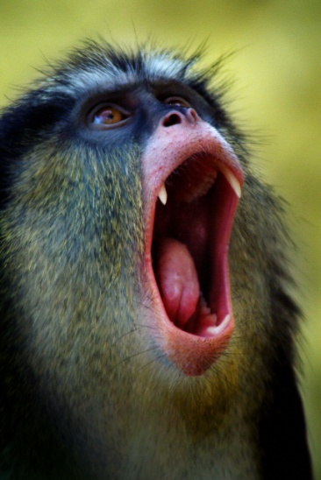

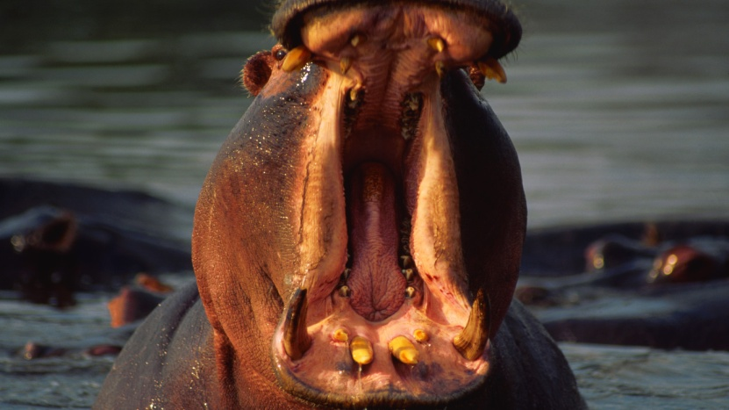
The cat went along the wall.
Ban Boring Sentences
We help the children develop their sentences by using VCOP.

Slide 14




Let’s get the VCOP superheroes to work on saving us from the boredom of boring sentences!

Slide 15

The cat went along the wall.
Vocabulary adds adjectives
to describe and changes dull
words for interesting
alternatives!
The fluffy ginger cat prowled
along the red brick wall.

Slide 16
The fluffy ginger cat prowled
along the red brick wall.
Connectives
add more detail or action to the sentence.
The fluffy ginger cat prowled along the red brick wall because he was spying on a juicy bird.

Slide 17
The fluffy ginger cat prowled along the red brick wall because he was spying on a juicy bird.
Openers change the beginning of the sentence to grab your reader’s attention!
Whilst licking his lips, the fluffy ginger cat prowled along the red brick wall because he was spying on a juicy bird.

Slide 18
Whilst licking his lips, the fluffy ginger cat prowled along the red brick wall because he was spying on a juicy bird.
Punctuation makes an impact
- using different punctuation.
Whilst licking his lips, the fluffy ginger cat (who had sharp teeth) prowled along the red brick wall because he was spying on a juicy bird!

Slide 19
The cat went along the wall.
We went from:
To:
Whilst licking his lips, the fluffy ginger cat (who had sharp teeth) prowled along the red brick wall because he was spying on a juicy bird!
Using VCOP!
What a wonderful way to improve our writing!

Slide 20
Children are encouraged to...
Talk about their writing
Find exciting words and use these in their writing.
‘Borrow’ exciting words and phrases from other authors. ‘WOW’ words.
Have a go at using interesting examples of punctuation.
Have regular opportunities to write for an extended period of time.
Re-read their own writing and find ways to make it better.
Understand what they need to do next to improve.

Slide 22
Helping your child at home:
Talk, talk, talk!
Read, read, read!
Be a model
Create real opportunities
Praise
Focus on content
Make it fun

Slide 23
Children need to
believe that they
can achieve and that
they can always
improve.

