Slide 1
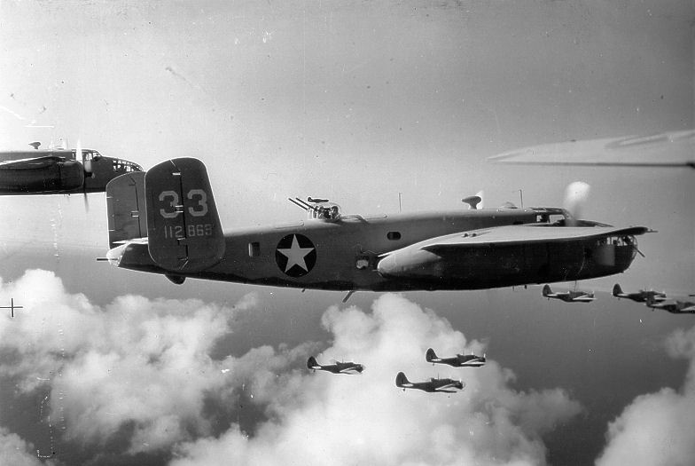
WORLD WAR 2
By Erin and Isaac

Slide 2
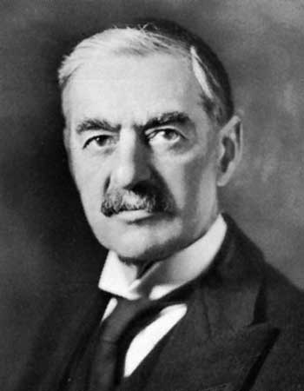
NEVILLE CHAMBERLIN
He has a famous speech
Neville declared war on Germany the day after Germany
Invaded Poland and told them to drop
Of their troops at Poof they would declare
war
Click for video

Slide 3
ADOLF HITLER
Adolf Hitler was a Nazi and the German leader. He was the one that mad the second world war real. He was the German leader from 1933-1945. Adolf Hitler was the Nazi party leader and he became a powerful dictator.

Slide 4
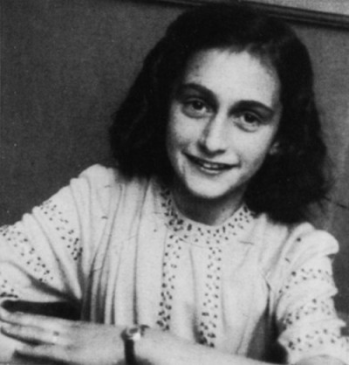
Anne Frank
Anne Frank was a Jew, but Adolf Hitler didn’t like them. He would send them to labour camps.

Slide 5
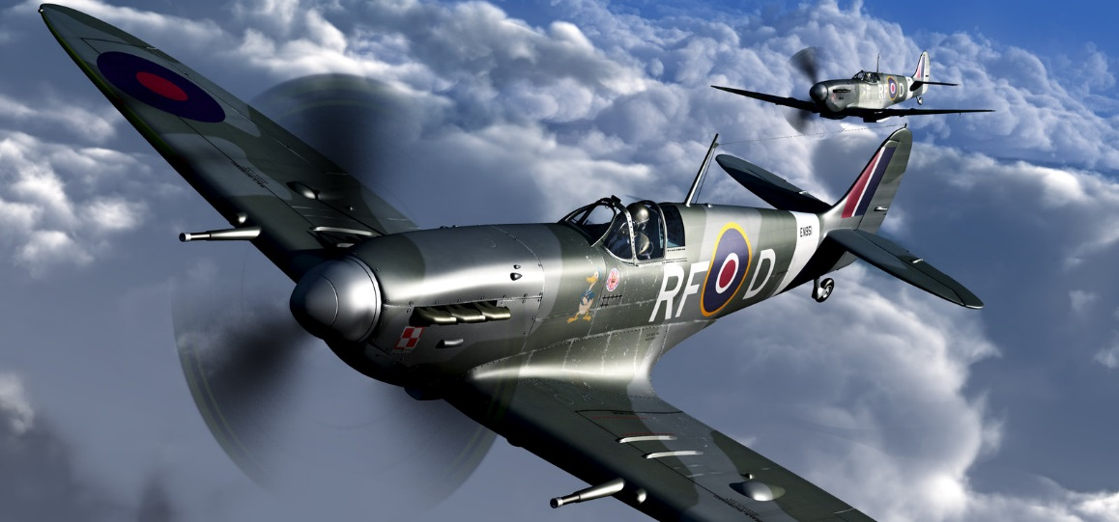
The Air Forces
The two air forces the RAF and the Luftwaffe. The fighter planes for the RAF were the Spitfire and the Hurricane and the planes for the Germans were the Messerschmitt BF109 and the Heinkel.
Click for video.

Slide 6
The Good Night Mr Tom Book
Click the book for a trailer.

