Slide 1
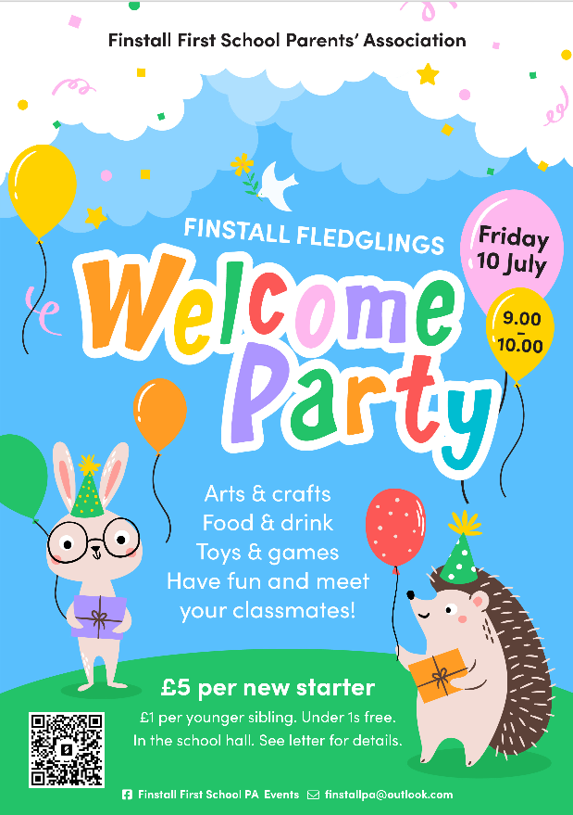

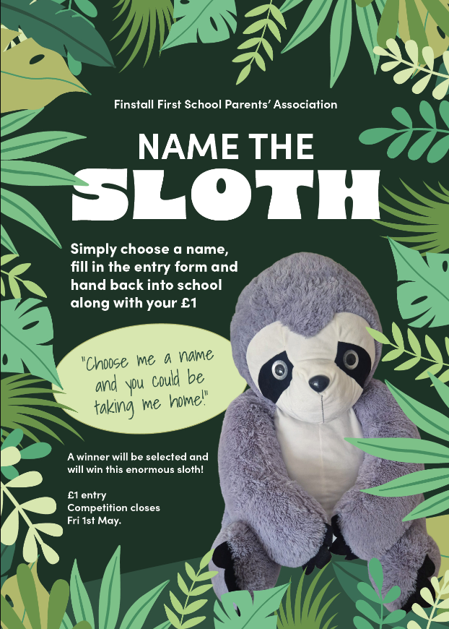

Welcome to Finstall
From Finstall First School Parents’ Association (the PA)

Slide 2
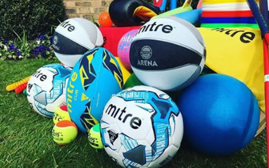
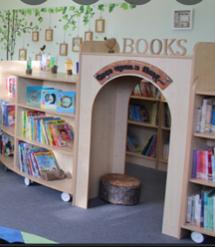
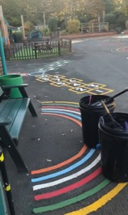
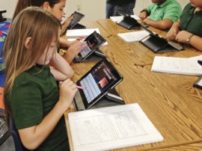
Who are we?
Finstall First School Parents’ Association (the PA)
A registered charity that is separate to the school but set up to support the school with fundraising activities
Raise money for projects the school budget doesn’t cover
PA committee:
  Louise Forrest, Co-Chairperson
  Tracey Beedon, Co-Chairperson
  Sarah Mellor, Treasurer
  Eve Vines, Senior Fundraiser
  Lynda Roberts, Design
Plus, a fantastic team of volunteers!

Slide 3

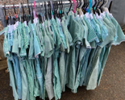


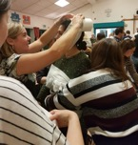



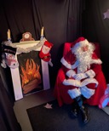
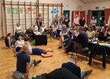
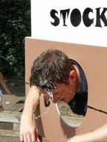
What do we do?
We use a variety of ways to raise money
Events: Christmas Fayre, Summer Fete, Parties, Uniform sales
Activities: Competitions, Sponsored Read, Trails, Dress-Up Days, Christmas Cards, Reception Tea Towels, Leavers Merchandise
Other revenue streams: Easyfundraising, Gift Aid
…and lots more!
We aim to instill a sense of community (amongst parents, teachers and pupils) and enhance our children's educational experience whilst at Finstall First School.

Slide 4

How are we doing so far this year?

Slide 5
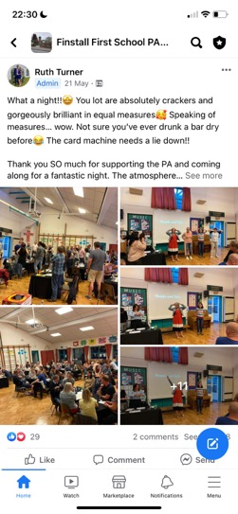

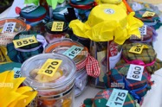

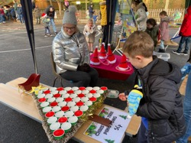

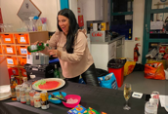

How you can help?
Volunteer to help at events (setting up / cleaning up / running a stall)
Supply events and activities with donations (prizes, sponsorship etc.)
Engage and communicate
Support by giving some of your hard-earned cash to a great cause!

Slide 6
Coming up…
FINSTALL FESTIVAL
Friday 19th June, 5.30 - 7.30pm
Hot food, cakes, licensed bar, games, stalls, a bouncy castle, year group stalls and our Grand Raffle with over 40 prizes!
Come and join us!

Slide 7
Coming up…
FINSTALL FLEDGLINGS WELCOME PARTY
Friday 10th July, 9.00 – 10.00am
A welcome party for all new starters
Toys, activities, crafts, snacks and the chance to meet your new classmates!

Slide 8
Thank you!
We look forward to seeing you all again!

