Slide 1
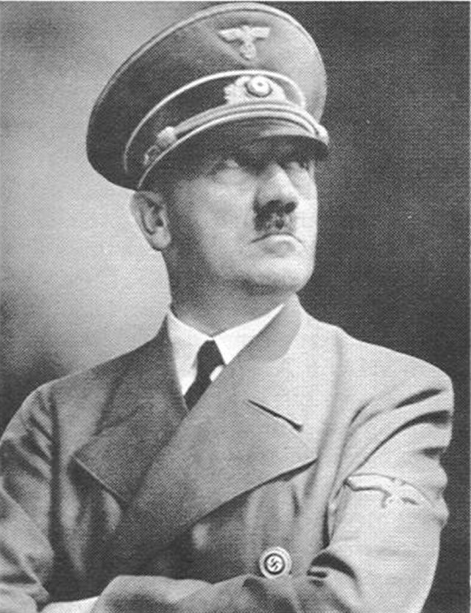
World War 2
Presented by Reuben and OLI

Slide 2
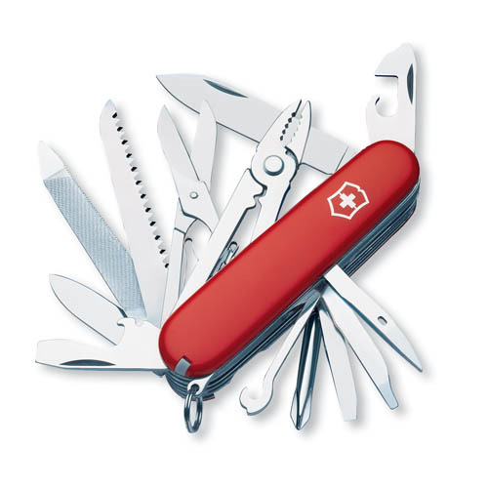

MEELY WEAPONS
This is a comando knife
This is a swiss army knife

Slide 3
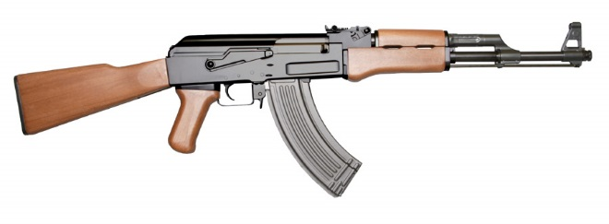
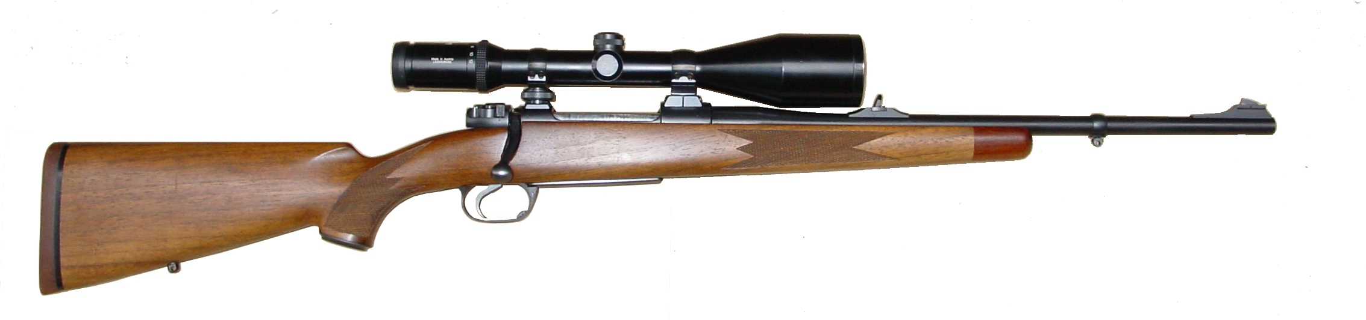
Guns
This is an ak-47
This is a rifle

Slide 4
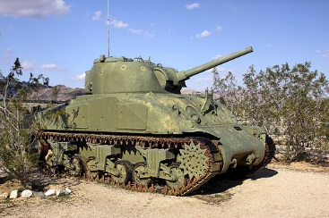
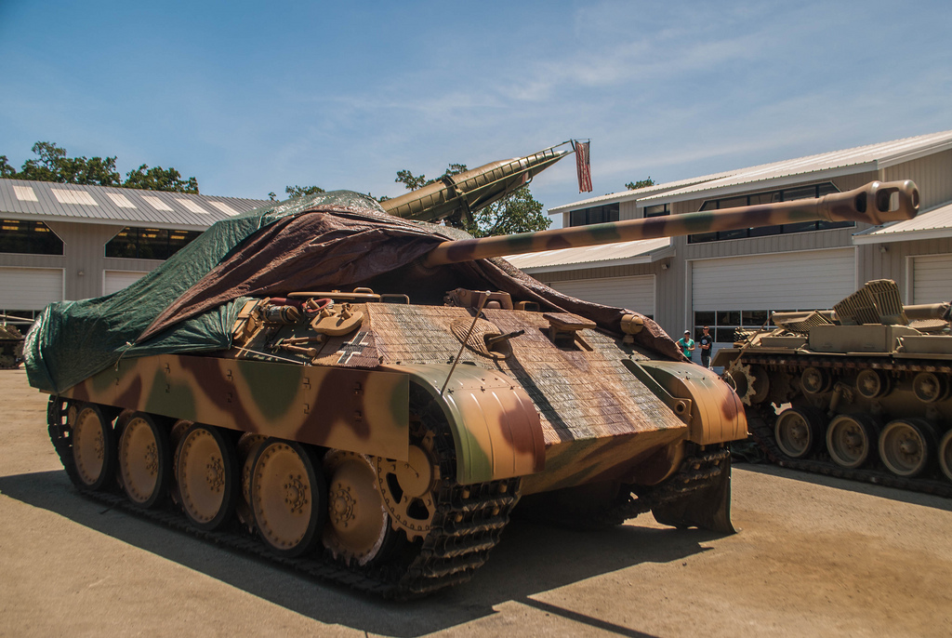
TANKS
This is a Sherman tank.
This is a panther tank.

Slide 5
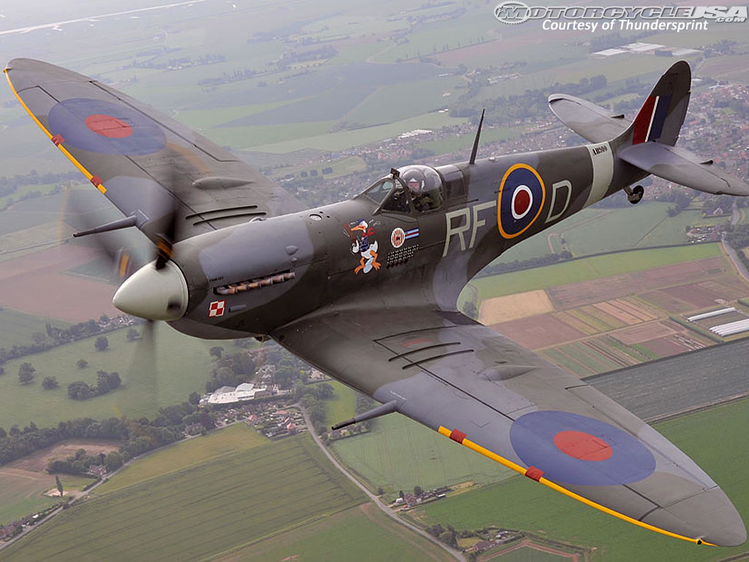
Click the picture for video

Slide 6
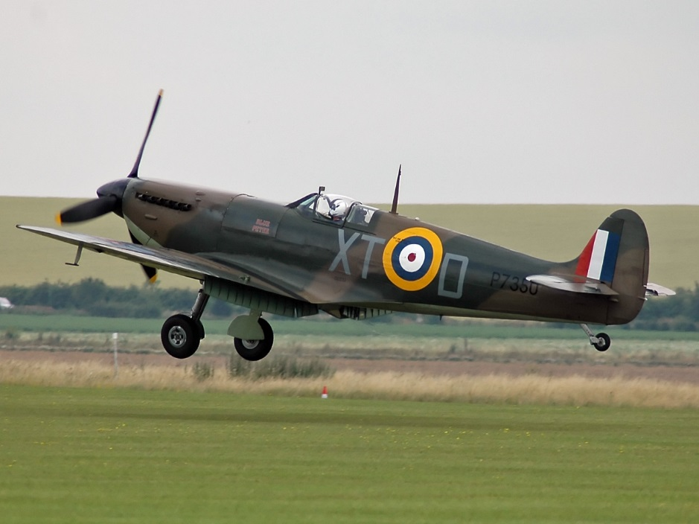
R.A.F

