Slide 1
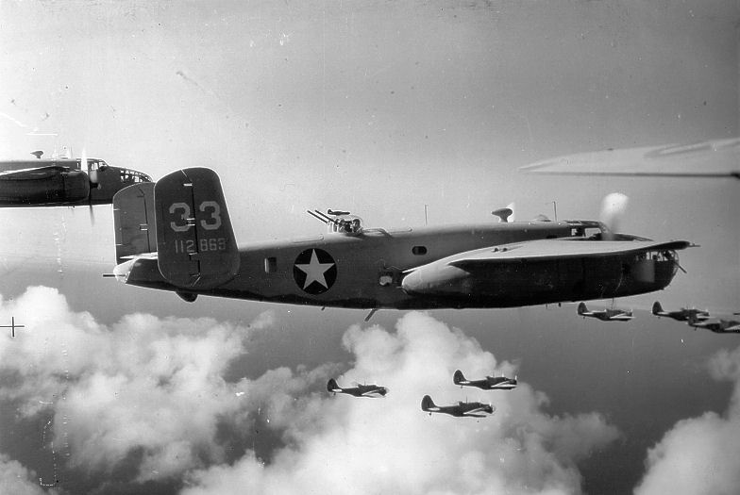
World war 2
By Connor and Sam

Slide 2
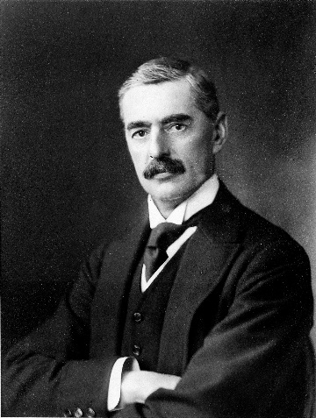
Nevil Chamberlin Neville chamblin
Nevil Chamberlin was the priminister in world war2 he was the man who declared war On Germany.
Neville Chamberlin famous speech
Click here for a video

Slide 3
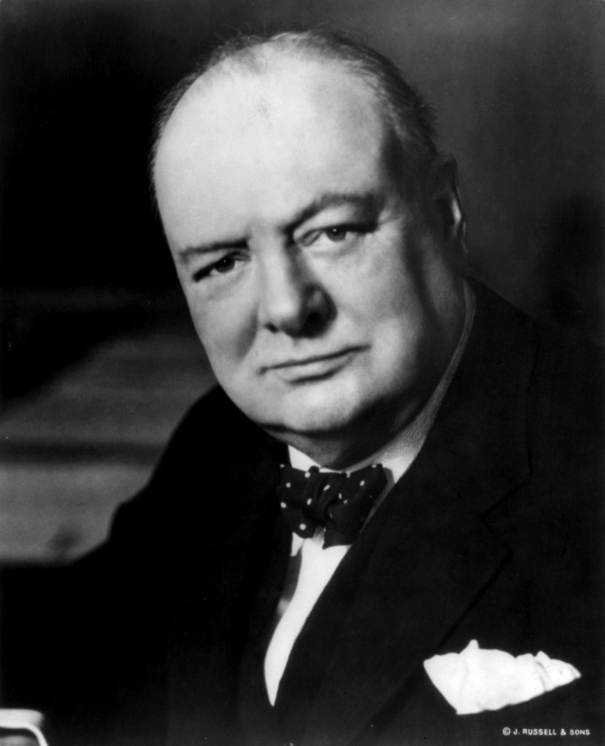
Winston Churchill
Winston Churchill was the priminister in ww2 after Nevil Chamberlin stepped down.
..

Slide 4
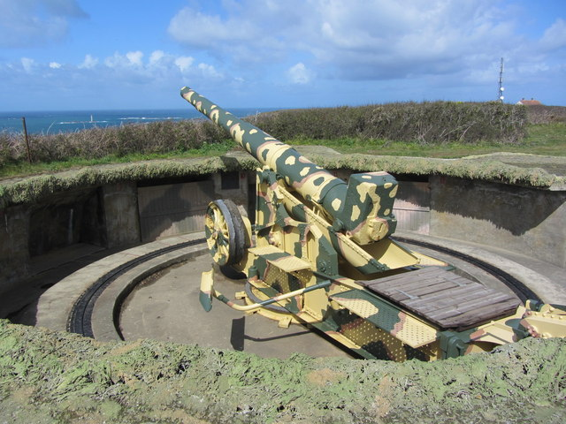
Weapons

