Slide 1
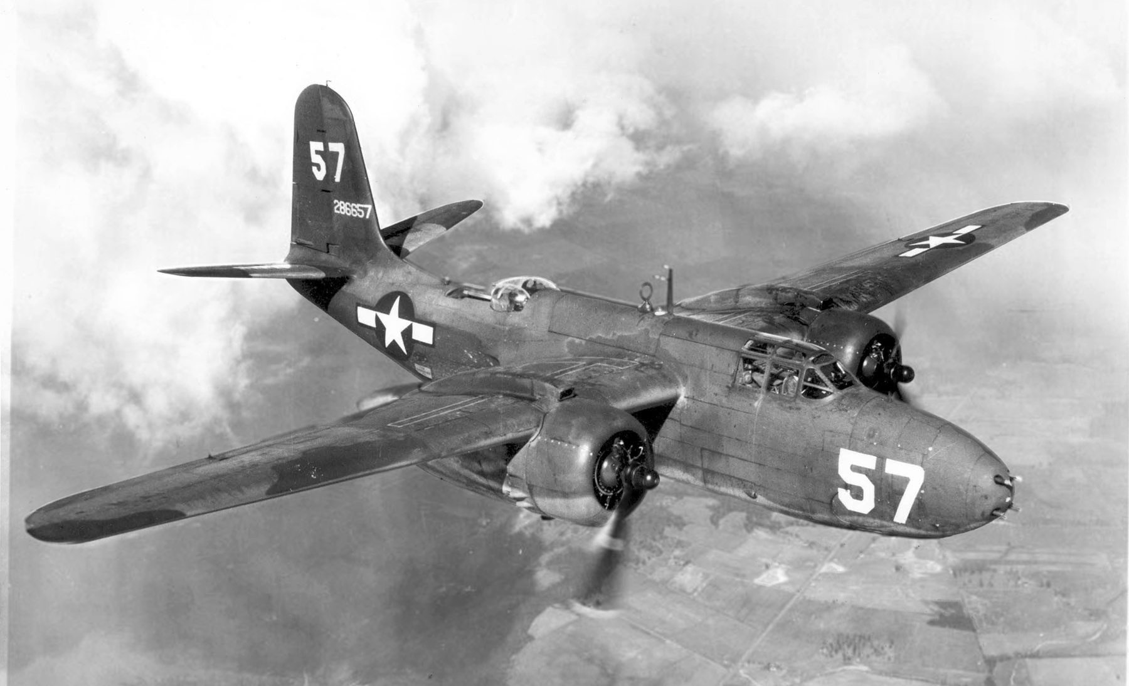
World War ii
Presented by Oscar and James

Slide 2
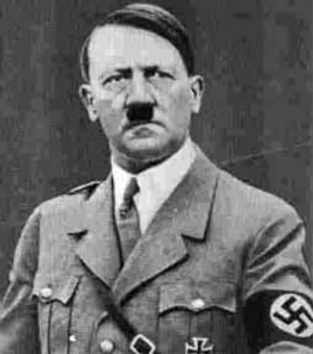
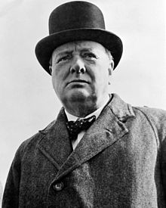
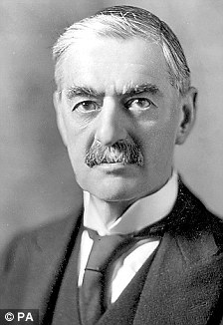
Important PEOPLE IN WORLD WAR II
Adolf Hitler
Winston Churchill
Neville chamberlain

Slide 3
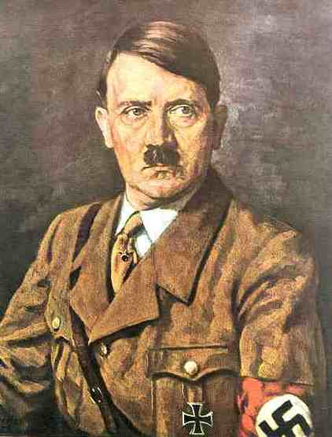
Adolf Hitler
Adolf Hitler was the leader of Germany from 1933 to 1945. He was leader of the Nazi party and became a powerful dictator.
Hitler started World War II by invading Poland and then invading many other European countries. He is also known for wanting to exterminate the Jewish people in the Holocaust.

Slide 4
Neville chamberlain
Quotes
We should seek by all means in our power to avoid war, by analysing possible causes, by trying to remove them, by discussion in a spirit of collaboration and good will.
How horrible, fantastic, incredible, it is that we should be digging trenches and trying on gas-masks here because of a quarrel in a faraway country between people of whom we know nothing.

Slide 5

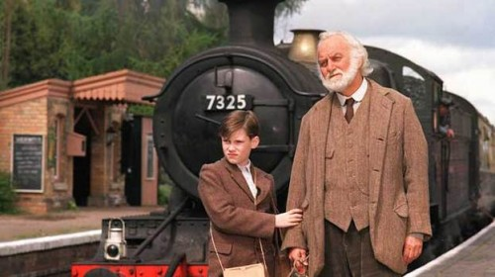
Press the picture to watch trailer
Good night Mr tom

Slide 6
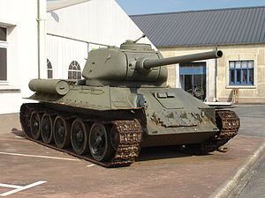
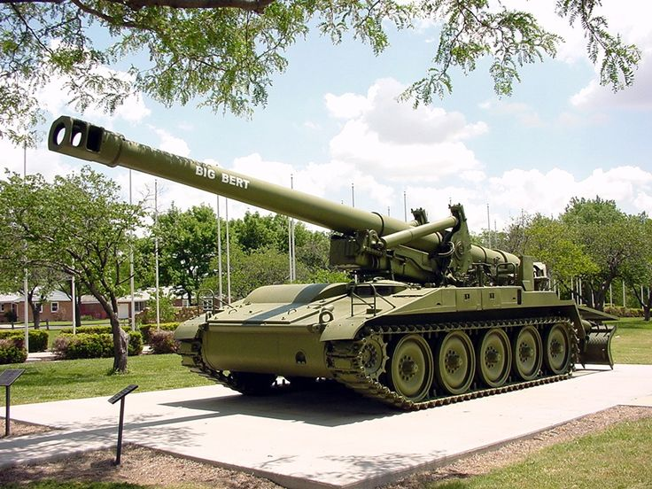

Tanks
T-34 - The T-34 was a medium tank which was first built in 1940.
It ended up being the highest produced tank in world war 2.

Slide 7
How the Normandy landings started
On the 6th of June, 1944 , the allied forces of Britain, America, Canada and France attacked German forces off the coast line of France

