Slide 1
World War 2
Presented by Ellie and Dylan

Slide 2
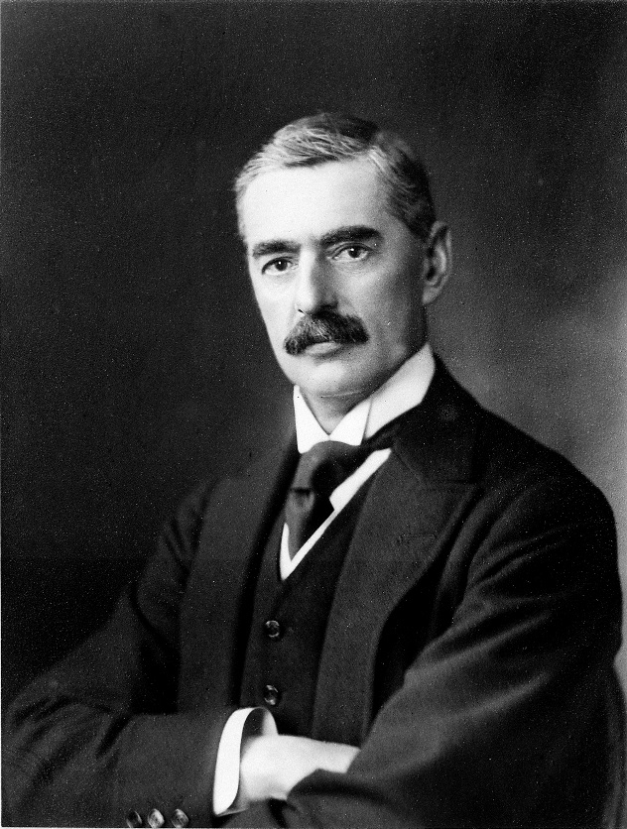
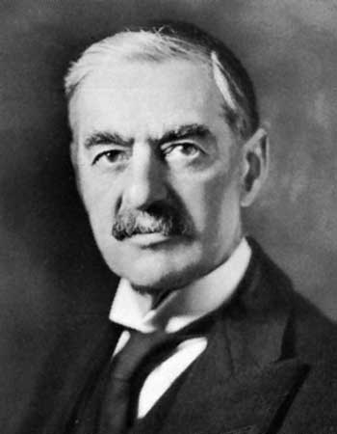
Neville Chamberlain
Arthur Neville Chamberlain,18 March 1869 –November 1940) was a British Conservative politician who served as Prime Minister of the United Kingdom from May 1937 to May 1940.

Slide 3
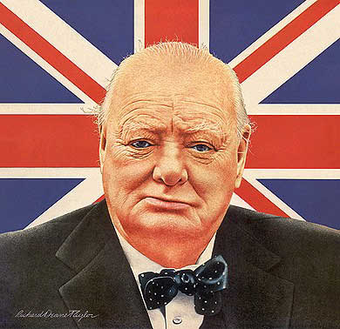
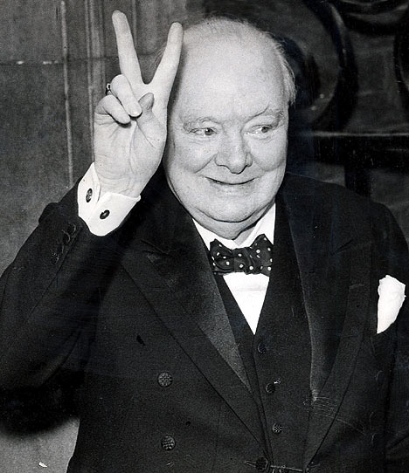
Winston Churchill
Sir Winston Leonard Spencer-Churchill (30 November 1874 – 24 January 1965)
Churchill`s Quotes
I have nothing to offer but toil ,tears , sweat and blood.
Success consists of going from failure to failure without loss of enthusiasm.

Slide 4
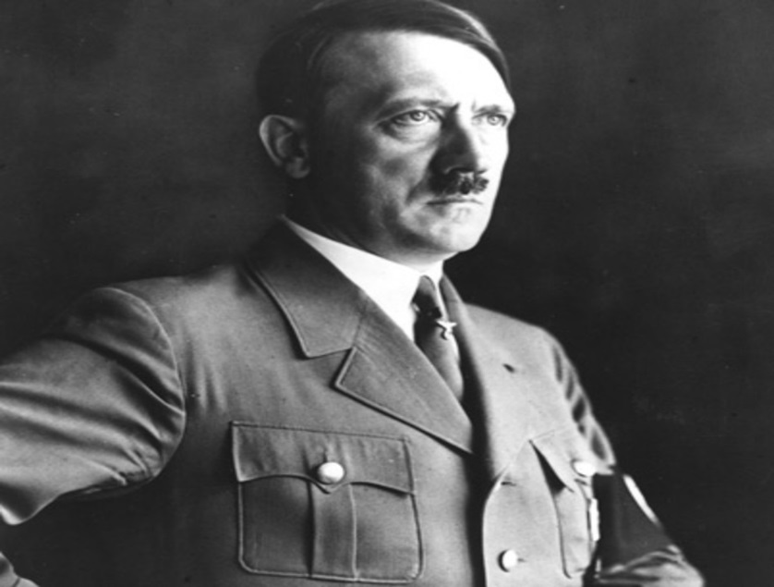
Adolf Hitler
Born; 20 april 1889. Died; 30 april 1995 at 56.
Adolf Hitler was actually Austrian not German.

Slide 5
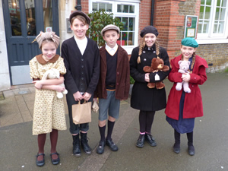
Evacuees in WW2
Click here for a video on evacuees.

Slide 6
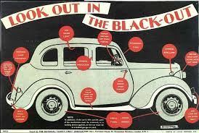
The Blackout
The blackout was a time in WW2 where everyone had to put up blackout blinds to prevent the Germans seeing the big cities and bombing them.

Slide 7
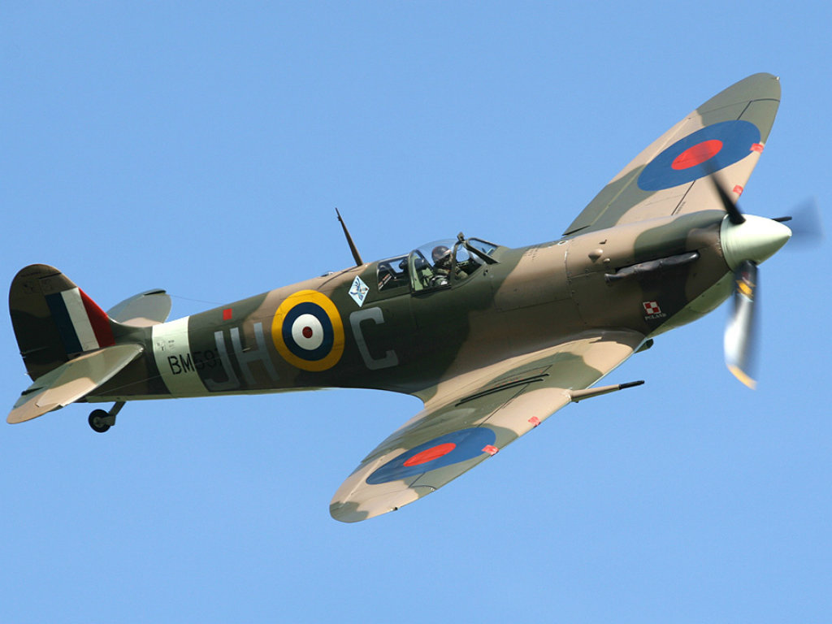
Planes in WW2
This is a spitfire in WW2.
Spitfires were the British planes in WW2 along with the hurricane and others.
However the German planes were the Messerschmitt and the Heinkel

Slide 8
Summary
Hope you’ve enjoyed learning about WW2.

