Slide 1
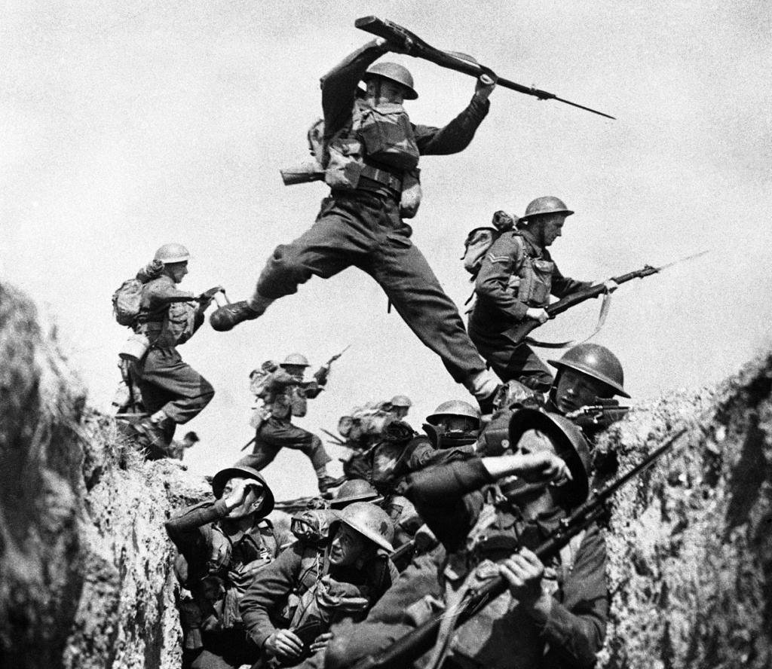
World War 2
Presented by Josh and Evie M

Slide 2
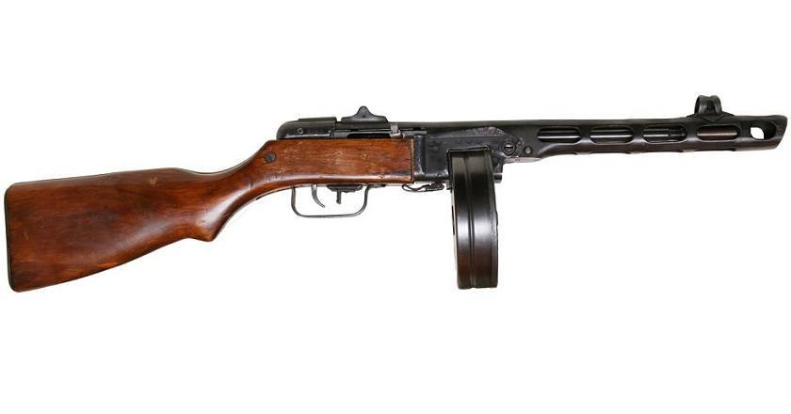
INTRODUCTION
During World War 2 there were over 20 countries, it involved our allies and axis.
All the children got evacuated to the countryside so they don’t get bombed.
Weapons
In World War 2 there were many weapons, for instance guns, knifes, bombs hidden in rats.

Slide 3
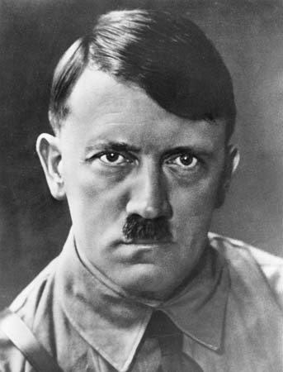
Adolf Hitler
Adolf Hitler was born in 1889 30th March, and happily died in 1945 30th of April. He killed himself by shooting a gun in his own head, later on that year his wife done the same thing.
He was the leader of the Nazi Germany.
He was also known for killing Jewish people
His Mum and Dad were called Klara Hitler and Alois Hitler.
His siblings were Edmund, Otto, Gustav, Alois j.r, Angela and Paula.
Hitler had an Iconic moustache
He had pushed across his hair
During the 1 WW Hitler got told to take his of mous
But he didn’t, he had a square patch above his top lip.

Slide 4
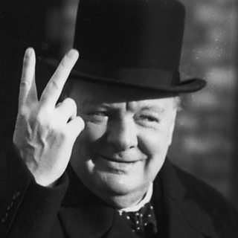
Winston Churchill
Born: 30 November 1874, Blenheim Palace
Died: 24 January 1965, Kensington, London
Spouse: Clementine Churchill (m. 1908–1965)
Education: Royal Military Academy
Click this picture to see Winston Churchill’s speech

Slide 5
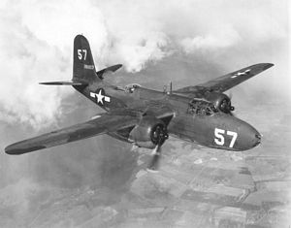
Planes
Click here to see the battle of Britain

