Slide 1
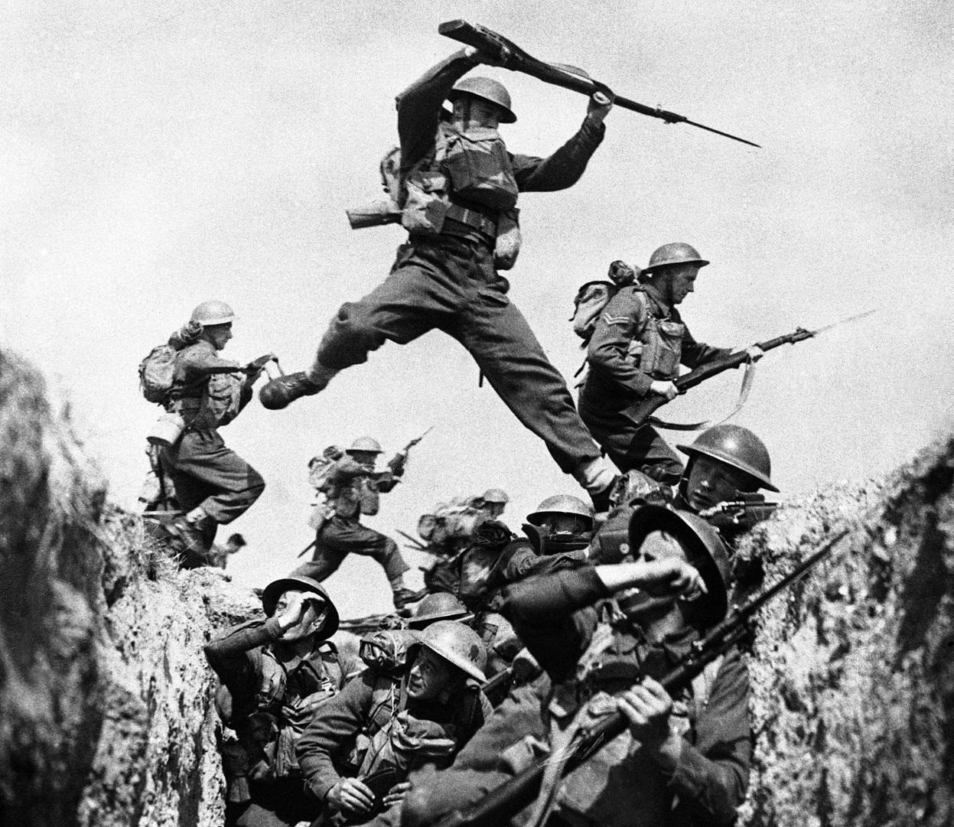
World War 2
Presented by Abbie and Finnley

Slide 2
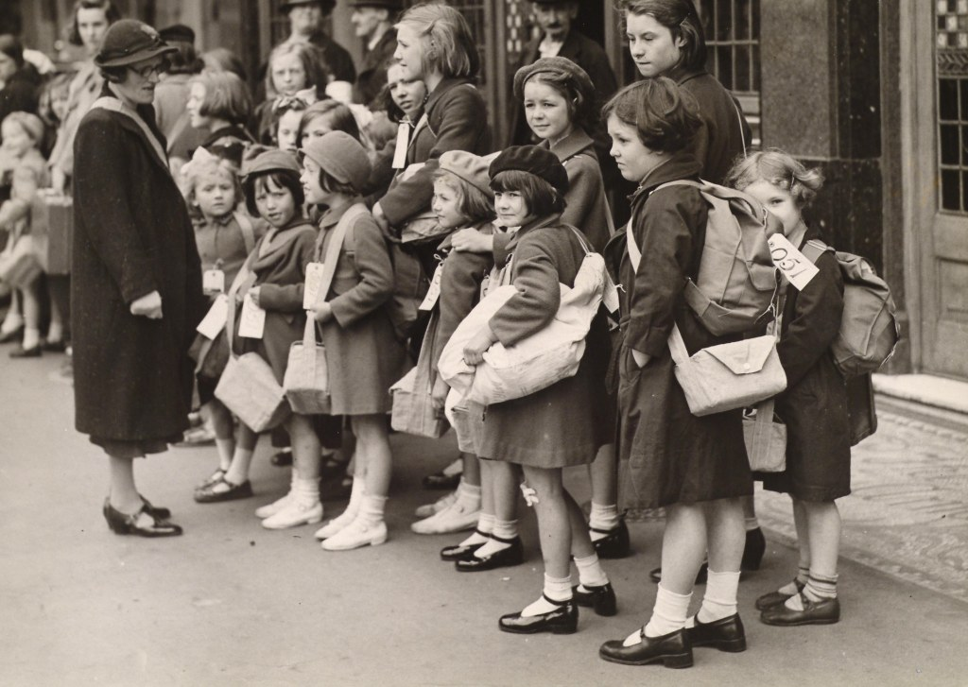
Children
During the war children were evacuated into the countryside. Most of the children were with parents that they don’t know but some people got put with people they know. All children got evacuated incept for the countryside children who didn’t need to be evacuated.

Slide 3
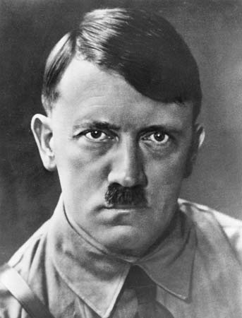
Adolf Hitler
Adolf Hitler, one of the worst dictators ever, if not the worst. Adolf Hitler killed 60 to 85 million people. His name brings connotations of murder. Adolf Hitler committed suicide at the end of the war and also his wife committed suicide. Adolf Hitler was born on 20th April 1889. he died on 30th April 1945. Adolf Hitler was born in Austria.

Slide 4
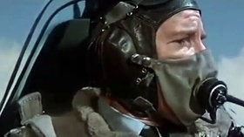
The Battle of Britain
On July the 10th 1940 Nazi Germany launched a surprise airborne raid against a British shipping convoy.
Click on this picture to see a trailer

Slide 5
Planes and their speeds

