Slide 1
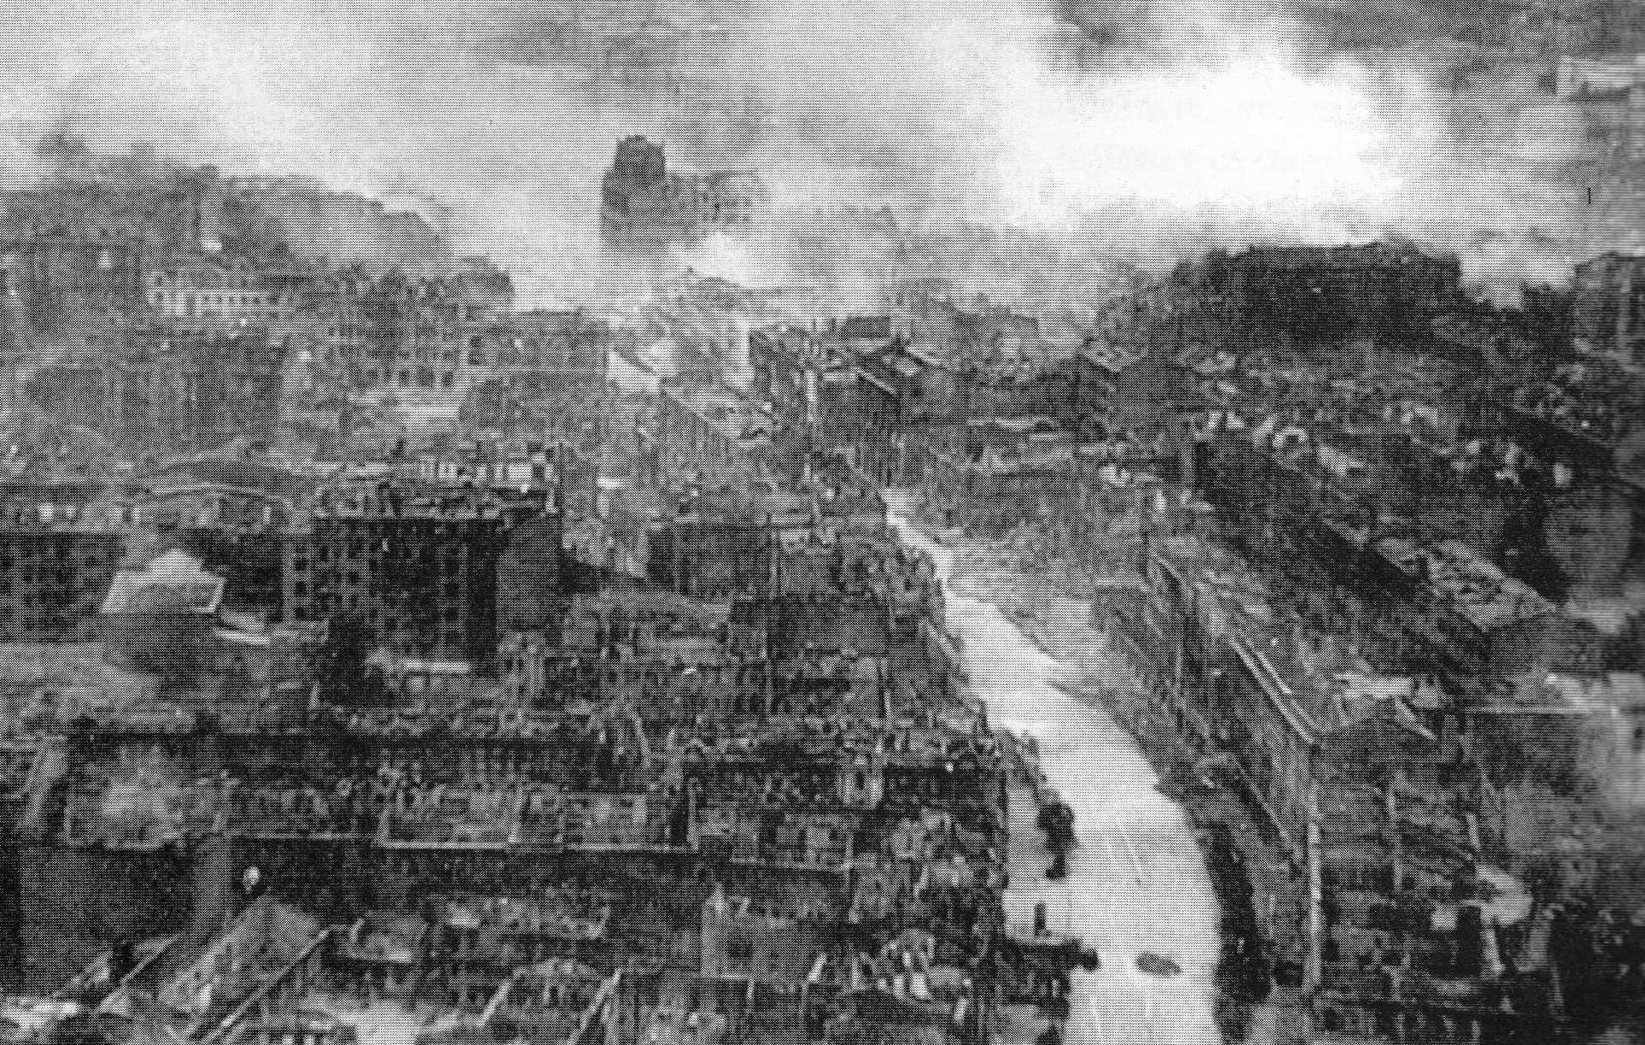
World War 2
Presented by Oliver and Harry.
(Click here to hear bombing on London!)

Slide 2
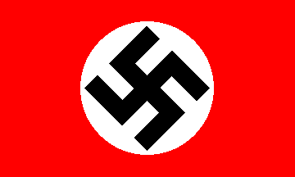
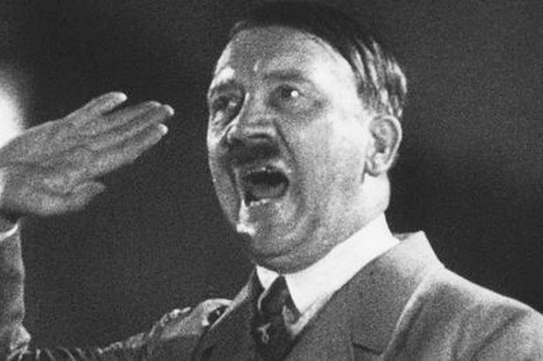
Famous People In World 2
Adolf Hitler
Adolf Hitler was the leader of the Nazi’s, he declared war
on Poland and by 11:00 clock and England would declare war on Germany by that time.
He was racist and would make any Jewish person in Germany wear a star and he’d take them to a war camp.

Slide 3
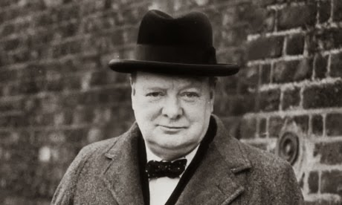
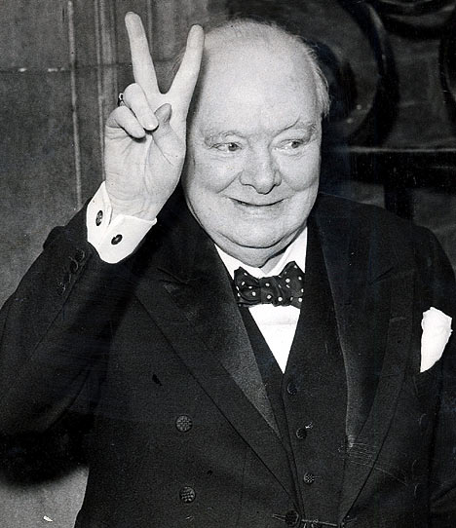
Winston Churchill
Winston Churchill was the Prime Minister of England in 1939. At 11:00 O’clock in 1st September 1939 and he declared war on Germany because he wouldn’t get his German troops out of Poland.

Slide 4
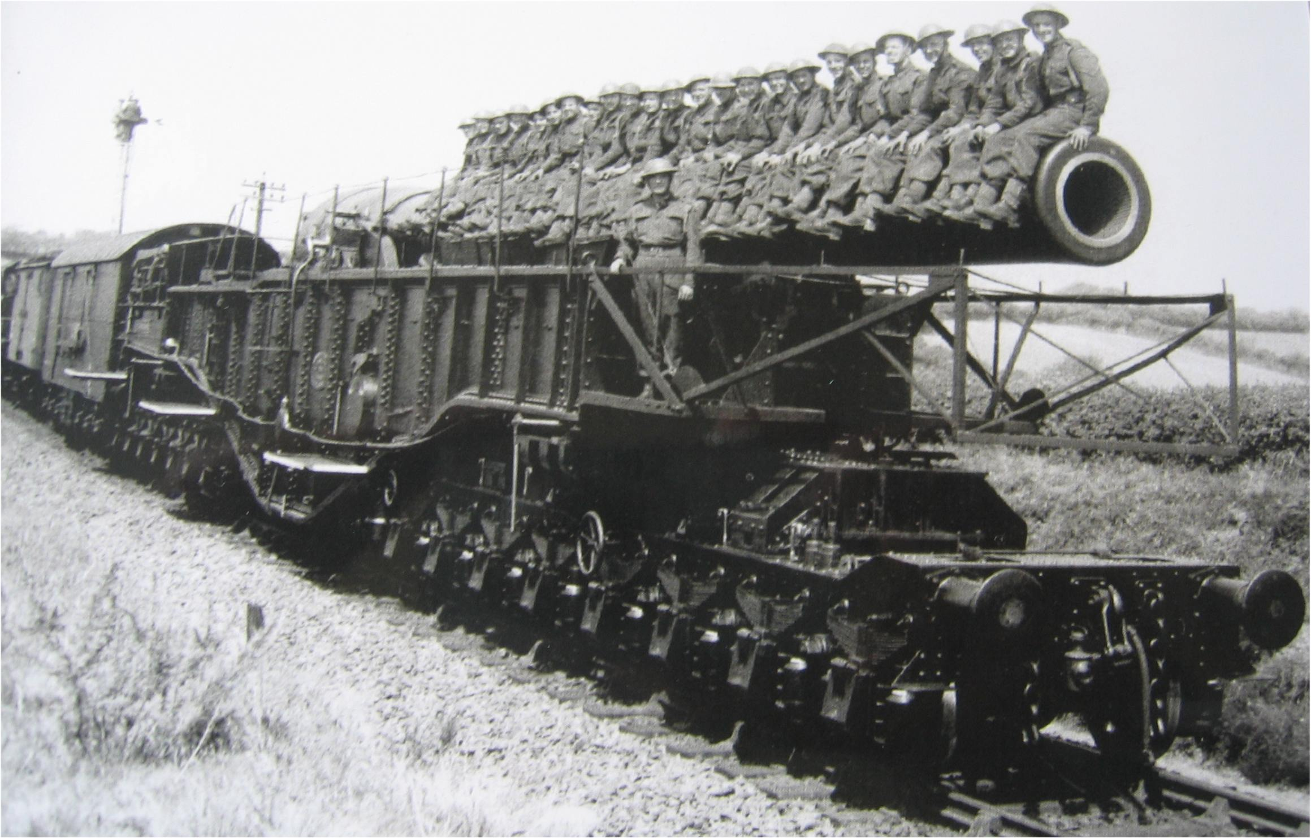
Artillery and weaponry
Click here to watch Neville Chamberlain speech!!
In World War 2 they used LOADS
Of different weapons and tanks, planes and turrets! Although it wasn’t the greatest time there was the most amazing weapon

