Slide 1
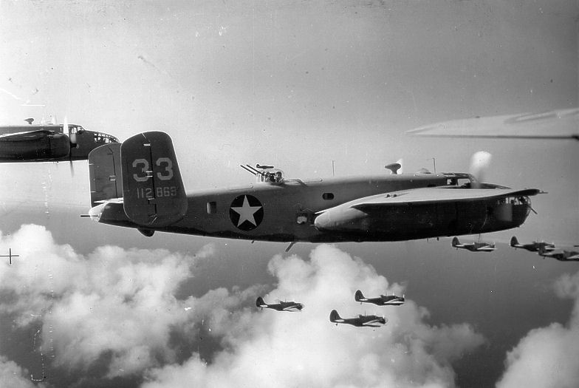
World War 2
Presented by Orla Millie and Sienna
4j

Slide 2
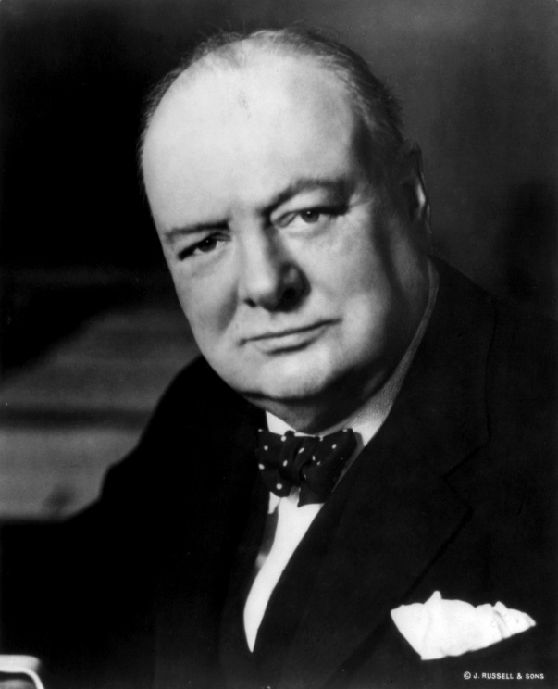
When war broke out
When the war broke out, everyone was told to listen to the wireless to hear the prime ministers speech.
Click the picture to listen to the speech.

Slide 3
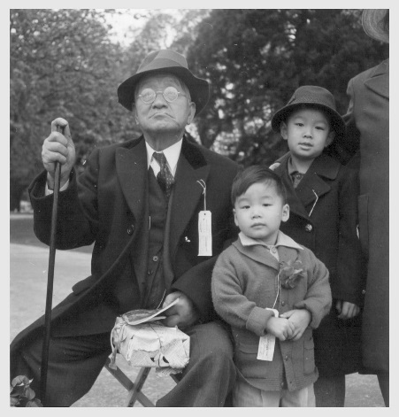
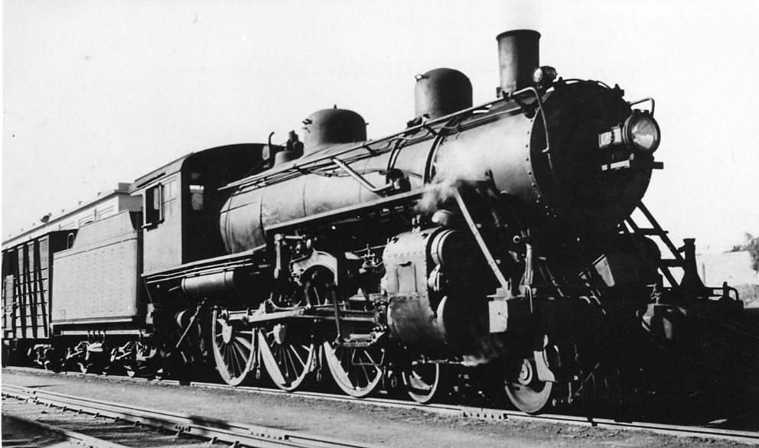
Evacuees
Evacuees were children that got evacuated from the city to the country side. The reason why they had to go to the country is because those children were the next generation and they were a bit weaker.
The children would either had to wait in a hall to be picked or the billeting officer would take them around the village and knock on peoples doors for them to take care of the children.

Slide 4
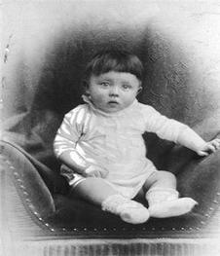
Adolf Hitler
Adolf Hitler was the leader of the German team.
He declared war in December 11th 1941.
He was born in April 20th 1889.
He first started the war by invading Poland.
Adolf Hitler killed himself in April 30th 1945.
Adolf Hitler as a baby

Slide 5
rationing
The rationing in WW2 was when you had coupons so you could only have a small amount of food. It was very important that you didn’t waste your coupons because the ration was on and the amount of food started to decrease. The ration was caused by the Germans cutting off the food and other goods.

Slide 6
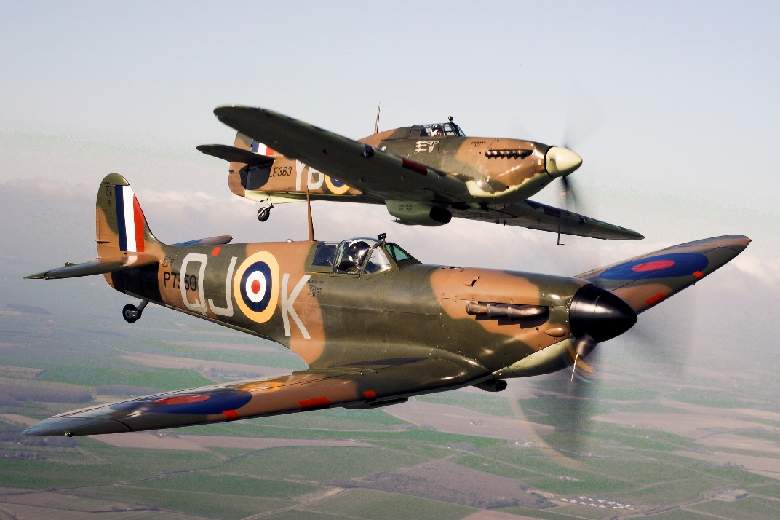
Planes

Slide 7
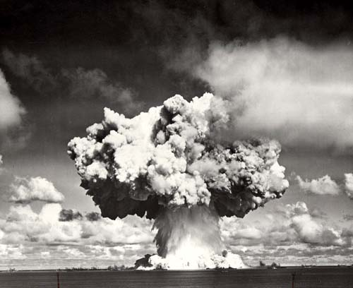
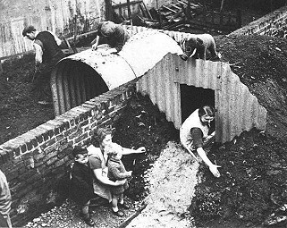
Ww2 bombs and Anderson shelters.
WW2 bombing normally happened at night when most people were sleeping. They had to run to their back gardens or undergrounds (sometimes they had to stay there for a whole day) some bombs were quite big and would cause a lot of damage.

