Slide 1
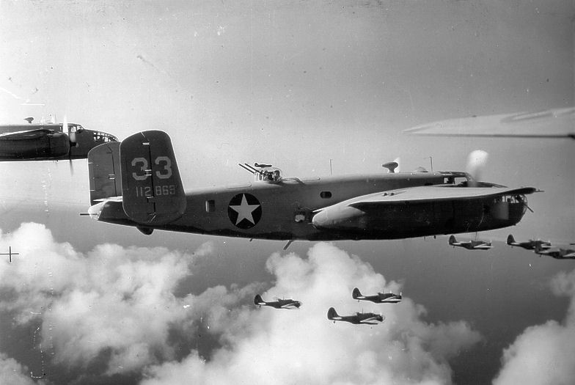
WORLD WAR 2
By William Wetherall and Evie g

Slide 2
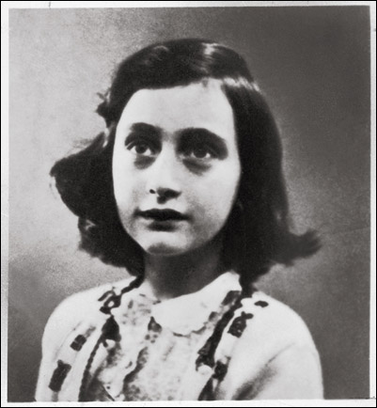
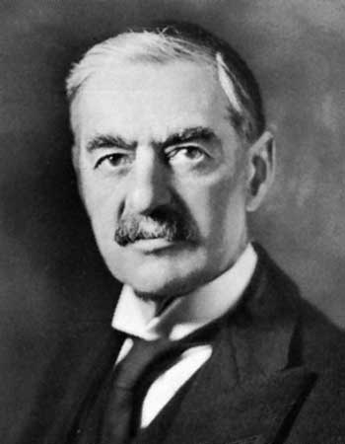
IMPORTANT PEOPLE
Click on the picture hear for a video
!!!!!!
Anne Frank
Neville chamberlain

Slide 3
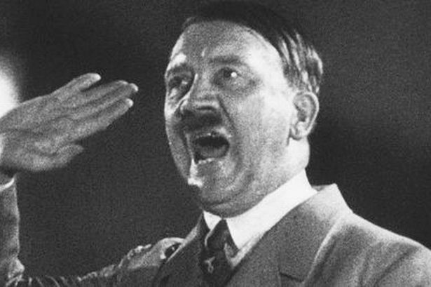
ADOLF HITLER
Hitler was the only Nazis leader he committed suicide and did it in his own apartment he was a phicopath.

Slide 4
The blitz
the blitz was a hazard to all people in ww2 it is one of the biggest bombing runs ever for Germany .

Slide 5
JEWS
The jews in ww2 were being treated like dirt in Germany( hitlers racist).
A big complaint to us. As if I didn’t care I would be with hitler but I’m not racis
Yeah I’m not racist like you thought .

Slide 6
BOOKS IN WW2
Click the hyper picture to see the trailer for goodnight Mr Tom!

Slide 7
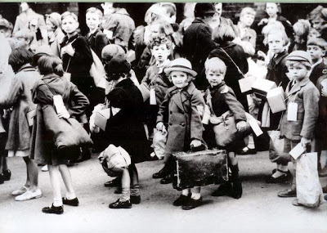
Evaccuaee
THE EVACUEES WERE NORMAL KIDS THAT WERE BEING EVACUATED(OBVIOUSLY >_< ) .BECAUSE OF THE BOMBING!RICH PEOPLES KIDS ALSO HAD TO BE EVACUATED $_$ !

Slide 8
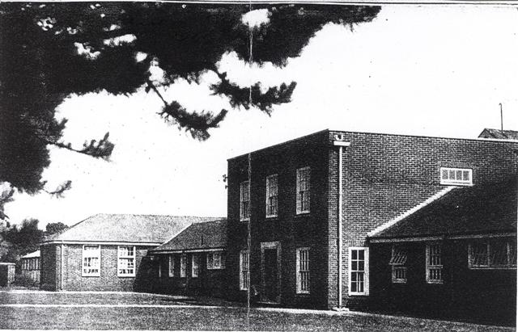
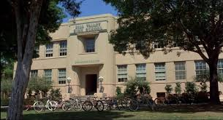
SCHOOLS IN THE WAR
Just compare these schools and you will see differences

