Slide 1
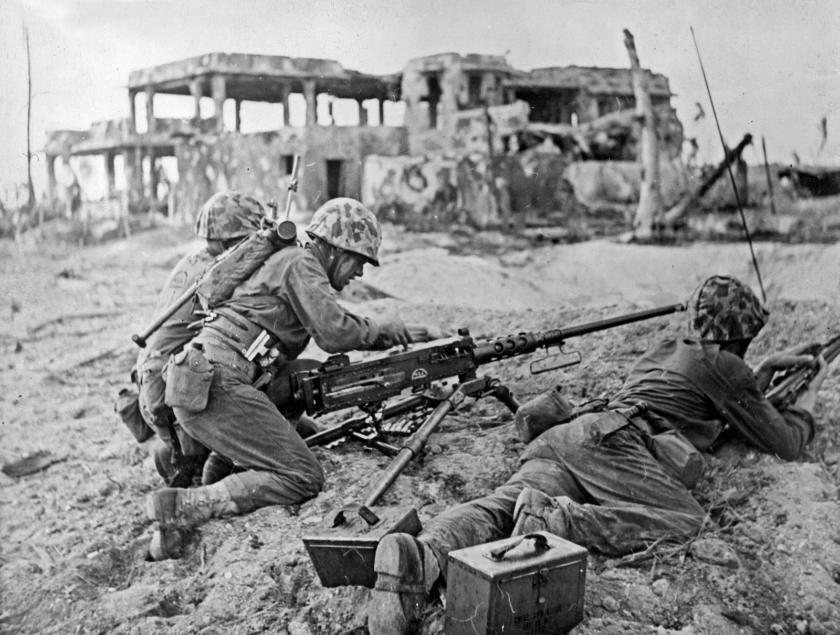
World War 2
By Harry M and Jay D

Slide 2
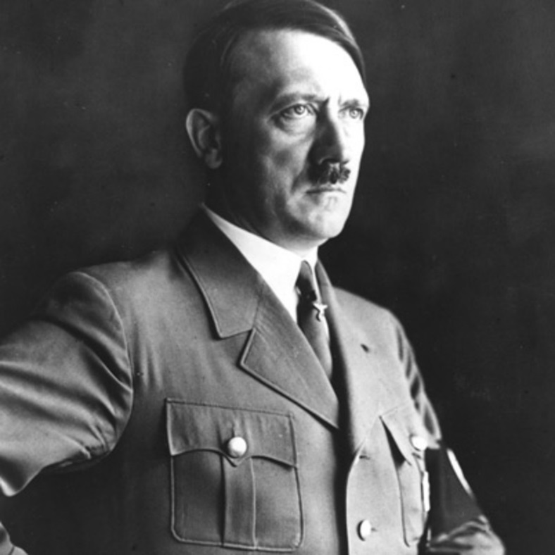
Adolf Hitler
Hitler was a very mean man and wanted to kill all the Jews so that he could take over Europe. He kept people in something
Called a Concentration Camp and torched them. Hitler used to spy on the Nazi’s before he joined them. It was known as
The Nazi Party. His father died when Adolf was only 14!
He died on the 30th April 1945
He was born on the 20th April 1889

Slide 3
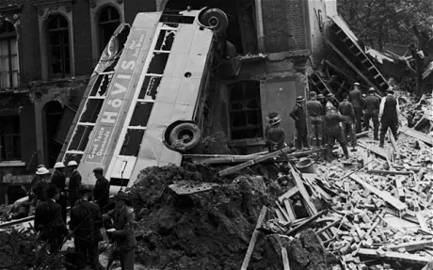
The Blitz
In 1944, Britain faced attacks from new weapons. First came the V-1, a robot 'flying bomb'. Then there was the V-2, a rocket which flew so fast no-one could see or hear it coming. London was the main target for V-1 and V-2 attacks.

Slide 4
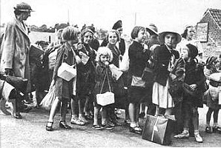
Evacuees
Children were sent from cities to places where there was less risk of air raids. Many London children went to Devon, Cornwall and Wales. Other children moved to villages in the North, East Anglia and Scotland.

Slide 5
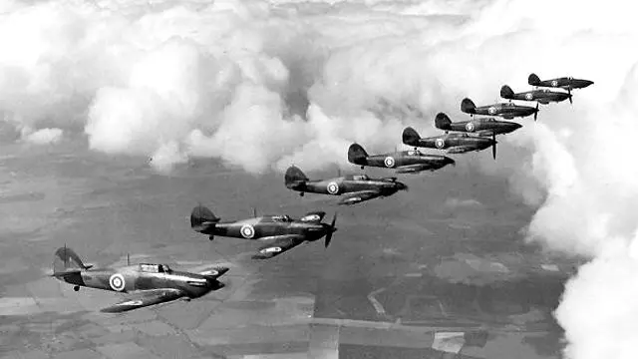
The Battle of Britain
The Battle of Britain started on July 10th, 1940. It lasted many months as the Germans continued to bomb Britain. The name comes from a speech by the Prime Minister of Great Britain, Winston Churchill. After Germany had overrun France, he said that "the Battle of France is over. The Battle of Britain is about to begin.

Slide 6
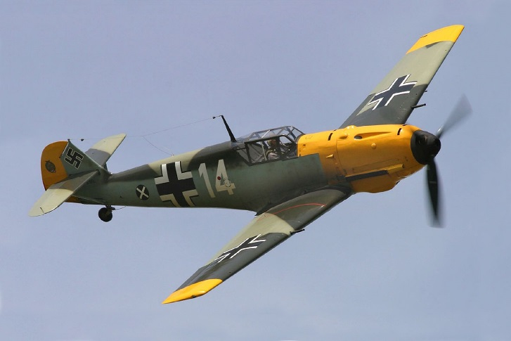
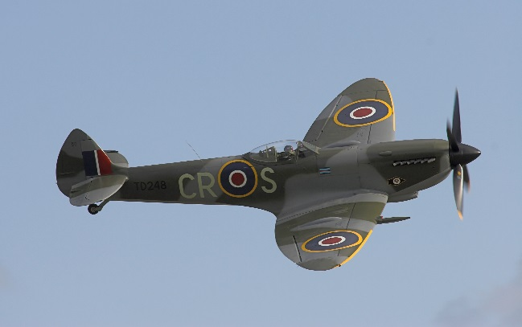
Epic Planes

Slide 7
Goodnight Mister Tom
Click here to watch a
Trailer of Goodnight
Mister Tom

