Slide 1
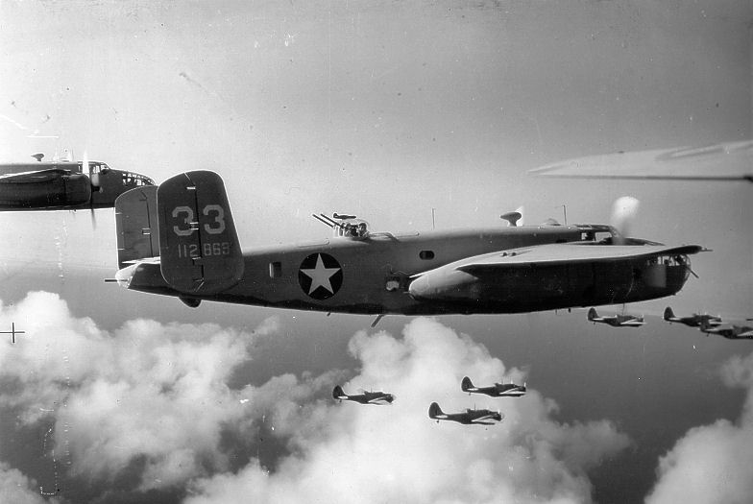
World War 2
Presented by Imogen and Euan

Slide 2
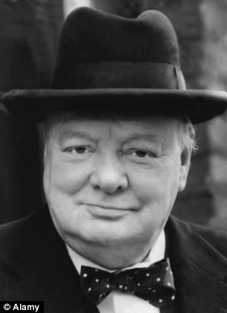
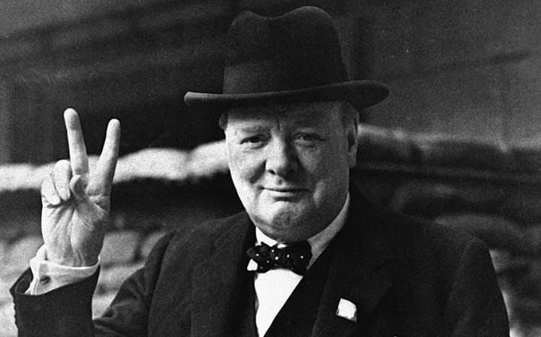
Winston Churchill
Winston Churchill got elected to be prime minister in WW2

Slide 3
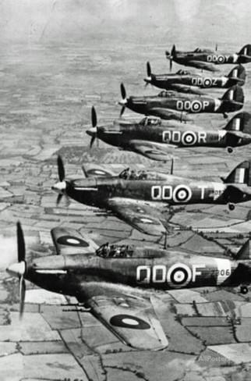
RAF
The RAF were plane flyers in WW2.

Slide 4
Evacuation
Click on the word BECAUSE
In WW2 children had to be sent away because of bombing. They had to go on a train with their teacher who would be their billeting officer.

Slide 5
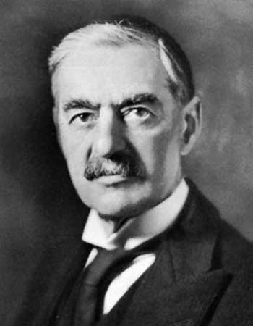
NEVILE CHAMBERLAIN`S
SPEECH!
Click on the picture for his speech!

Slide 6
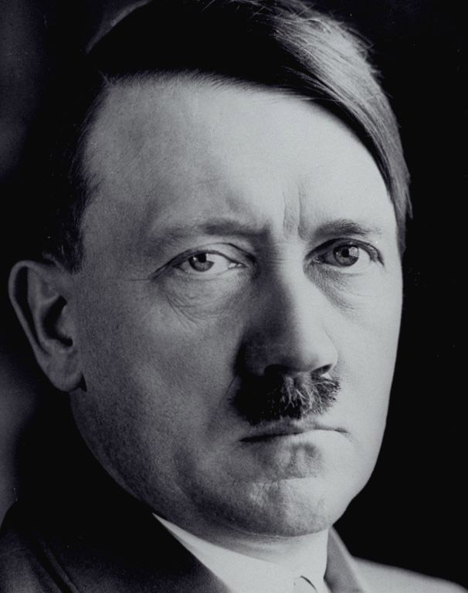
Hitler
Adolf Hitler was the leader of the German’s !

