Slide 1
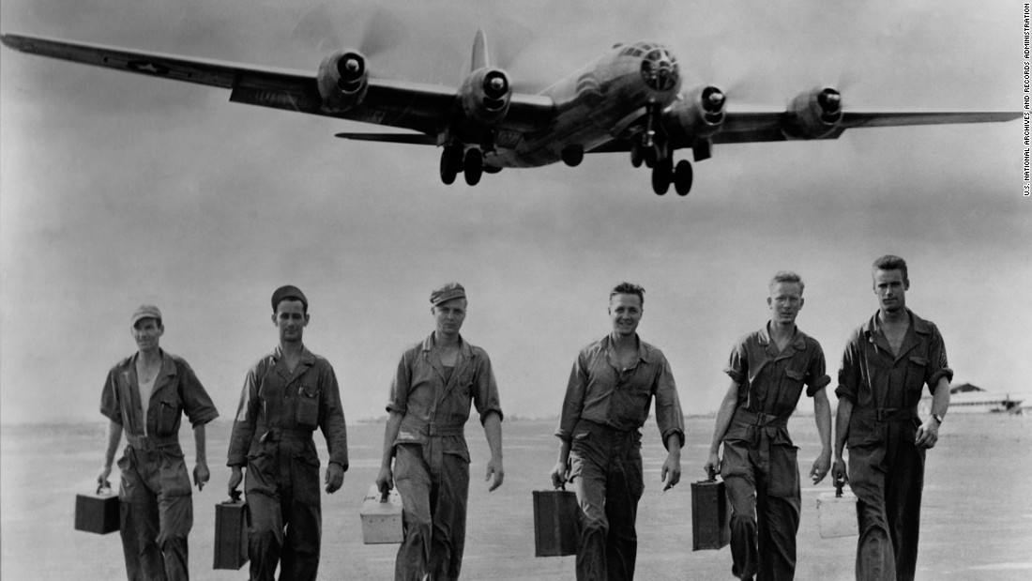
World War 2
Presented by James Harrod and Evie Hodgetts

Slide 2
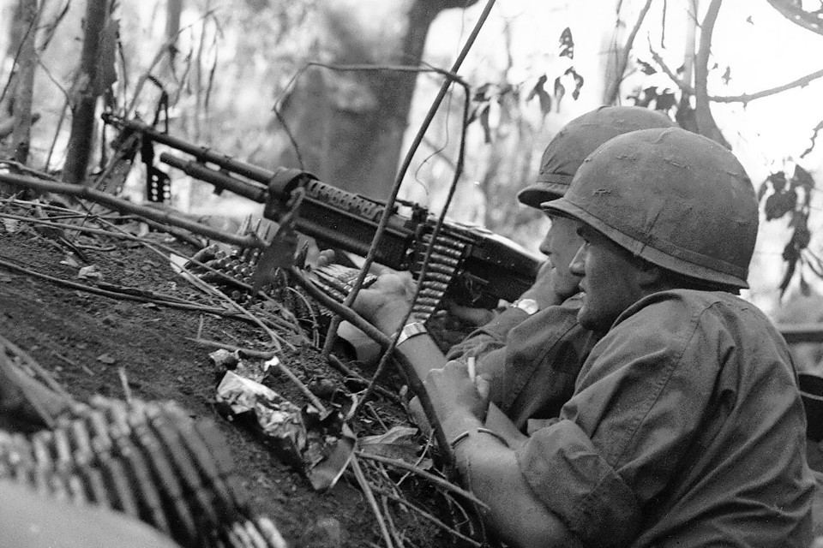
Soldiers
In WW2, Soldiers would carry a lot of kit. They would carry:
Their main weapon (rifle or gun)
Their bayonet (knife to stick on end of Rifle)
Their mess tin (tin of food)
A roll up mattress
A bread bag (a bag for bread and papers)
Some soldiers that were highly trained carried grenades
Any personal items (razor, books, soap, watch, etc)
Gas mask
Their dog tag (it would have the soldiers unit number on it)

Slide 3
WEAPONS!
Different types of weapons:
K98 rifle (main German weapon)
Bayonettes
Macine guns

Slide 4
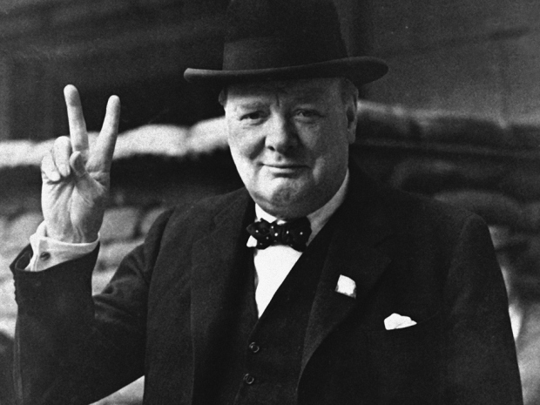
Winston Churchill
Winston Leonard Spencer-Churchill was born on the 30th of November 1874. He became prime minister in 1940. He was succeeded by Clement Atlee in 1945. He succeeded Neville Chamberlain. He went to boarding school and got mad at his teacher. He got mad because he was beaten for stealing a handful of sugar, so he kicked his teachers straw hat to bits. He made lots of famous quotes such as ‘Never in the field of human conflict was so much owed by so many to so few’ after the Battle of Britain and ‘Let us go forward together’.
Sadly ,he died on the 26th of January 1965, aged 90.
V for victory!
This is Winston Churchill.

Slide 5
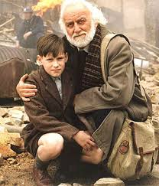
Goodnight Mr Tom
Click the book to watch the trailer of the film!!!!
Goodnight Mr Tom is a great book by Michelle Magorian. Magorian is an actress and bestselling author.

Slide 6
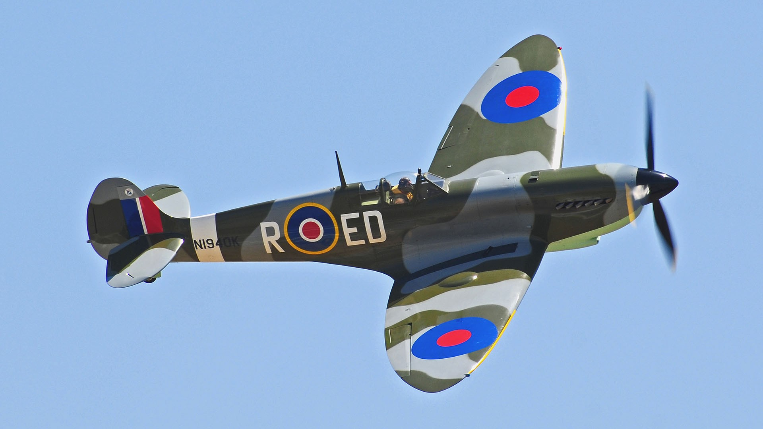
The battle of Britain
The battle of Britain was a battle fought in the air.
The RAF and the German Luftwaffe fought it in planes called :
Germans:
Junkers JU 88 bombers
Heinkel bombers
Fockewulfs
Messerschmit 109’s
British:
Hawker Hurricanes
Spitfires

