Slide 1
World War 2
Jessie and Chloe

Slide 2
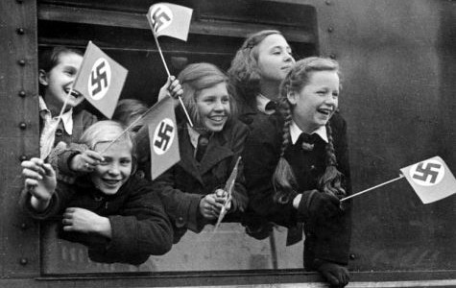
Evacuation
During world war 2 planes flew over London bombing the city ,so all the children had to be evacuated because they still had to live there life.

Slide 3
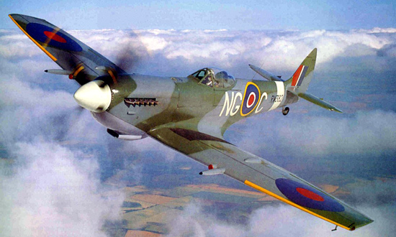
Planes
Click the picture to see a vidio

