Slide 1
WORLD WAR 2
PRESENTED BY MAX

Slide 2
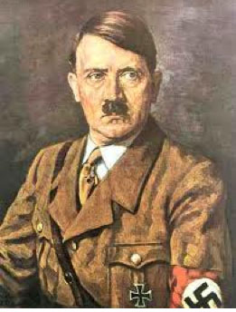
THIS IS HITLER he started the war in 1939.
He killed THOUSANDS of people.
He didn’t kill people who had blue eyes or blond hair

Slide 3
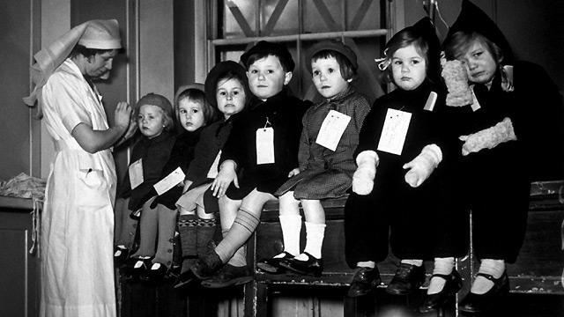
evacuees
Children were evacuated to the countryside.
They were sent all over the country.
When the evacuees were brought to the
different areas people choose who
they take home.

Slide 4
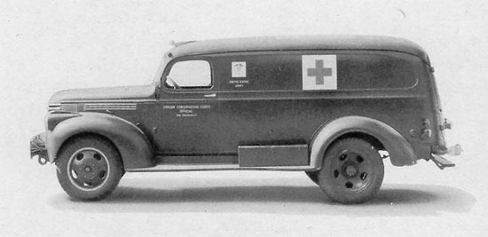
cars
In the war they used big cars like this one
It was a very good car to have. A positive is
It had a lot of room in it so injerd people
could have some room

Slide 5
Churchill's speech
https://youtu.be/E4MEjgKVQPo
This is a very important speech
Everyone heard it even Adolf Hitler

Slide 6
Great battle of Britain
https://www.youtube.com/watch?v=B4HSpmiR8Uo
The battle of britian is a very famous battle

Slide 7
GOOD NIGHT MISTER TOM

