Slide 1
World War 2
By Evie and Evelyn

Slide 2
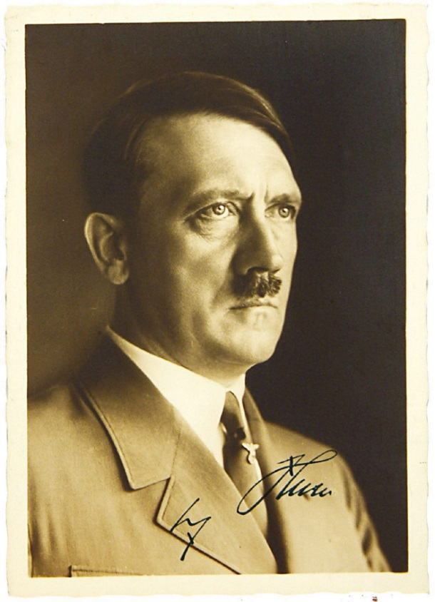
ADOLF HITLER
Hitler was a selfish man . He didn’t like Jews in fact he made them wear stars and if he ever saw one he will kill them. Hitler was the leader of the Germans. He declared war on Poland.

Slide 3
FACTS.
Fact 2/ the bombers liked to bomb big cities so children got evacuated to the countryside so they would survive the next generation.
Fact 1/ In world war two Judaism was a very popular religion it still is now but it was more popular in world war two.

Slide 4
WW2 planes
Wait until you see the amazing plane video in ww2.

Slide 5
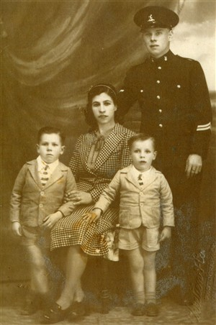
Families across Europe. felt in pain of the war . In Britian , father and sons were sent away to fight , children were evacuated and separated from their parents .

Slide 6
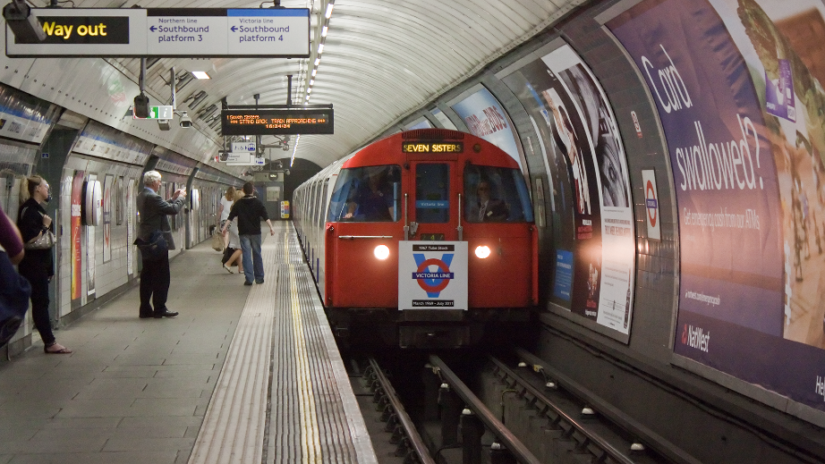
London ufnderground
The London under ground was a safe place to go when the air aid siren goes of, also it can fit lots and lots of people inside. It is very dark and gloomy its probably really scary for the people that sleep there when the planes drop bombs I would be scared a lot.

