Slide 1
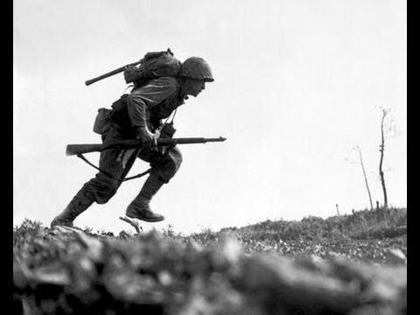
World War 2
Presented by Danny and Bethany

Slide 2
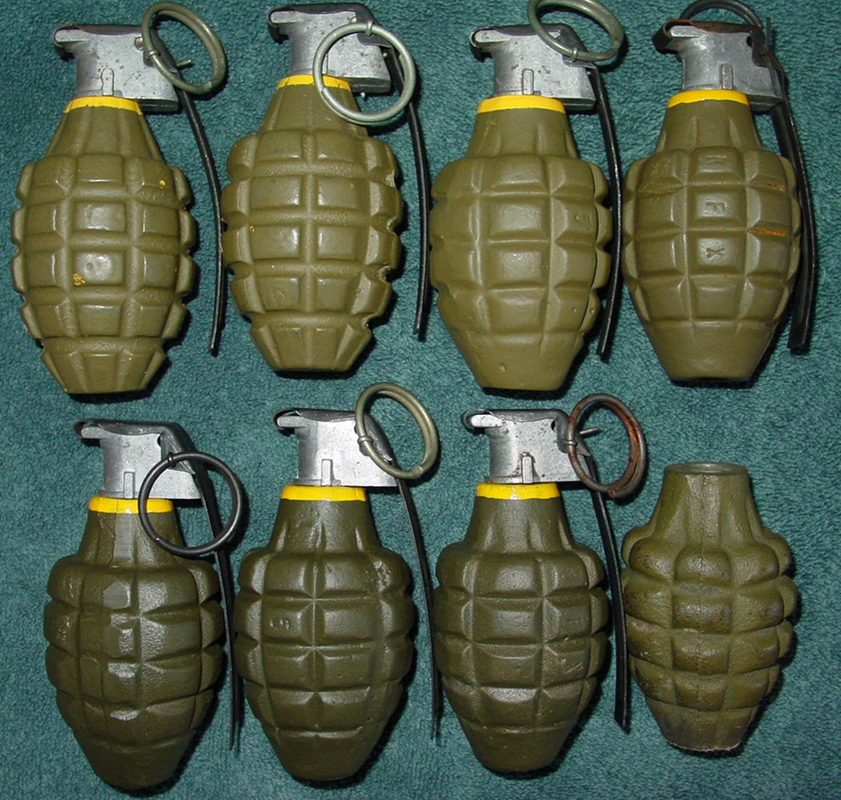
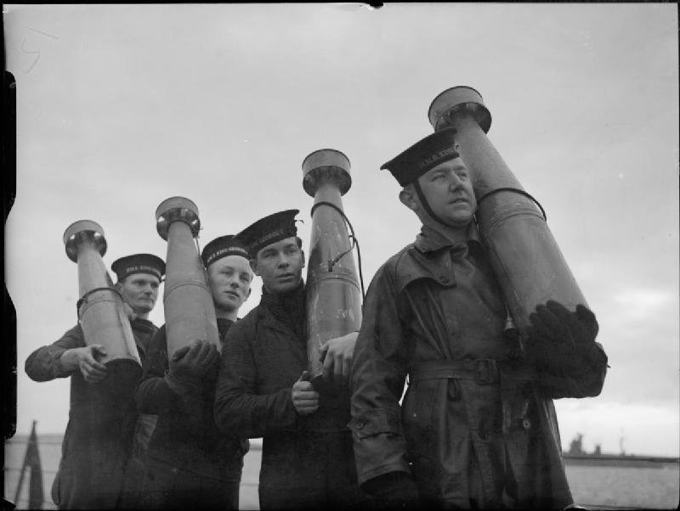
WEAPONS
A ship-mounted aerial mine rocket launcher
The unrotated-projectile rocket launcher was an especially ill-conceived antiaircraft measure. Created to protect ships from enemy planes, the unrotated projectile was fired from a ship, and, upon reaching 1,000 feet in elevation, it would explode and disperse mines attached to parachutes via 400 feet of cable.
Suicide bomb dogs
In 1942, Hitler's Nazi infantry invaded Soviet Russia with German "Panzer" tanks.
The Russians, who had used military dogs since 1924, sought to turn their canine soldiers into antitank mines by strapping explosives around the dogs' bodies.
During training, the dogs were starved and let loose on stationary Soviet tanks that had food hidden under them.

Slide 3
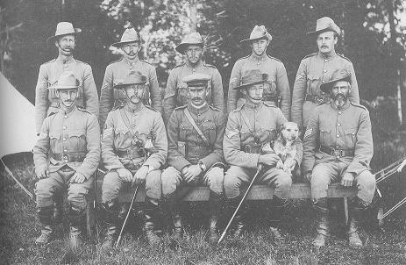
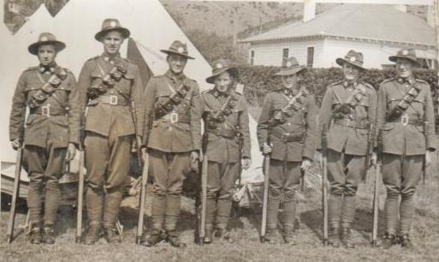
What did soldiers wear in world war 2
The Tommy's uniform had seen several changes since 1918, although the men were still recognizable as British soldiers. Waist-length, in a style called a blouson, with two chest pockets. The sleeves were now button-fastened at the wrist, like a shirt, making them far warmer and more waterproof. This style of tunic gave the wearer much more freedom of action and was generally well liked by the troops.

Slide 4
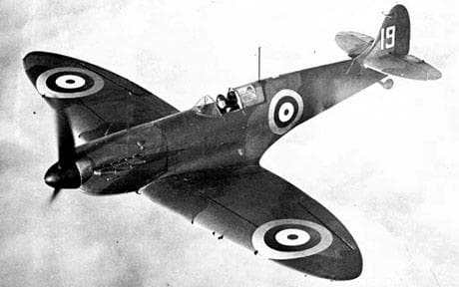
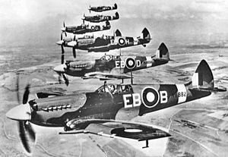
Battle of Britain
The 15 September 1940 was officially named Battle of Britain Day as it was the day when RAF Fighter Command claimed what proved to be a decisive victory over the German Luftwaffe.
German forces swept through France with remarkable speed in May 1940, invading the country on May 10, the same day that Winston Churchill became Prime Minister in Britain.

