Slide 1
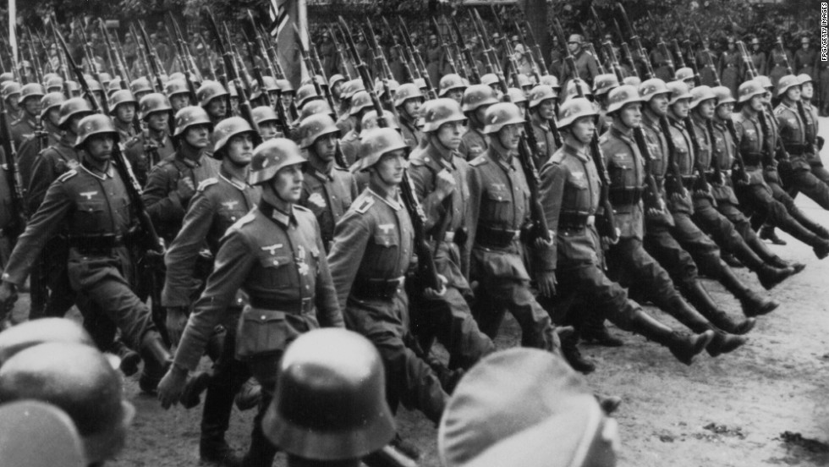
World war 2
Presented by Adam and Siena

Slide 2
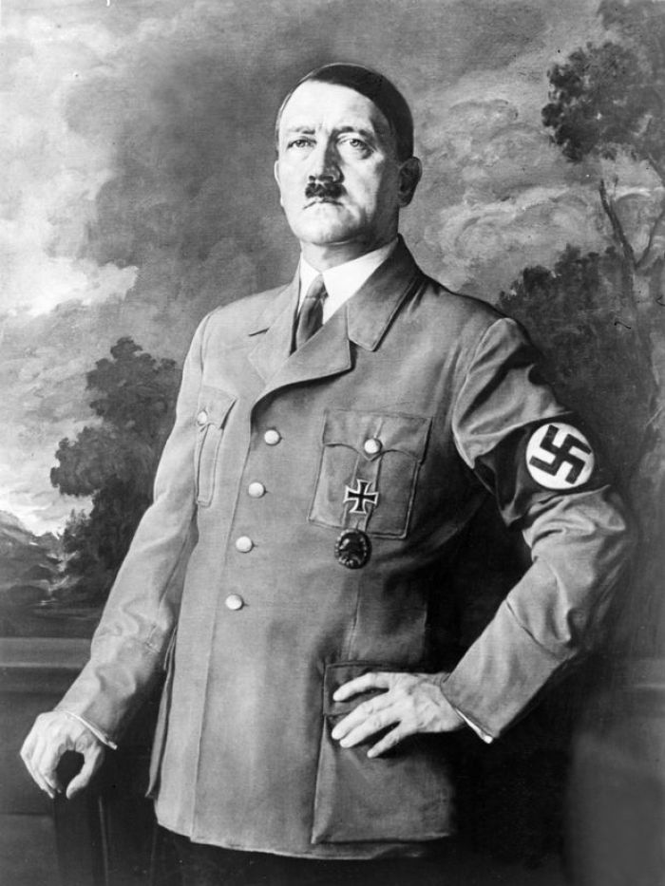
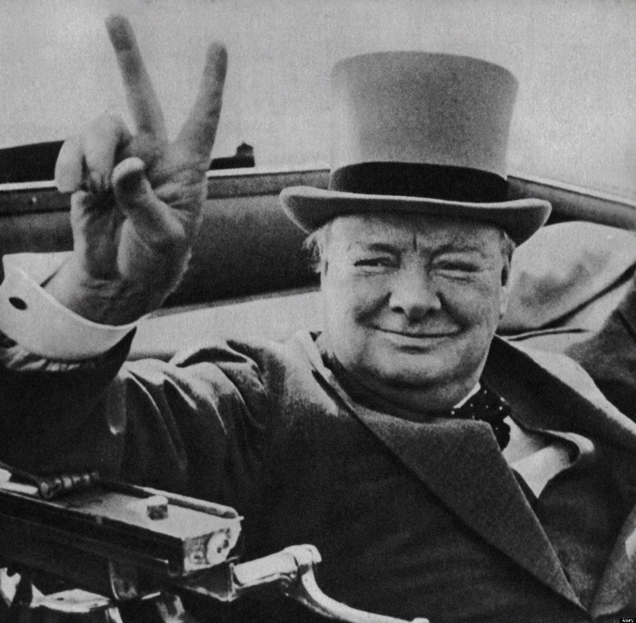
Main people in world war 2
Adolf Hiltler was the main person in world war 2.he started the war in 1939
Hitler wanted to kill all of the jewsish rase and he wanted to keep alive the people with blonde hair and blue eyes.
England declerd war on Germany to stop hitler from doing what he did.
Winston Churchill was the priminister of England in world war 2.
Winston Churchill did a v sign for victory.
Winston Churchill was famous for his speeches.

Slide 3
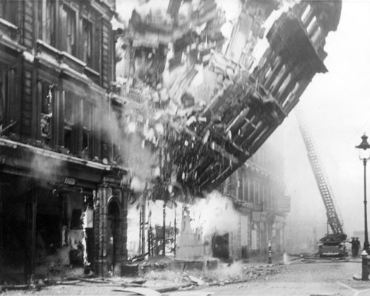
The blitz
. The blitz was a horrible bombing stage in ww2.
. Many people died in the blitz.
. In the blitz many houses were bombed or badly damaged.
. This is a quote one of the people that experienced the blitz “it was as if the ground was shaking”
.Winston Churchill was the prime minister at the blitz.
Tap here for a video

Slide 4
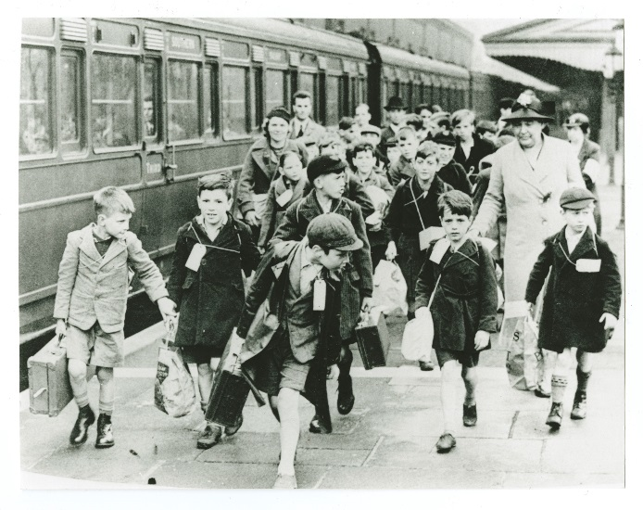
Evacuees
. All city children were evacuated in world war 2
.all the country side people weren’t evacuated because they were all ready safe from the bombs
.you were not guaranteed to get put with your symbling[s]

Slide 5
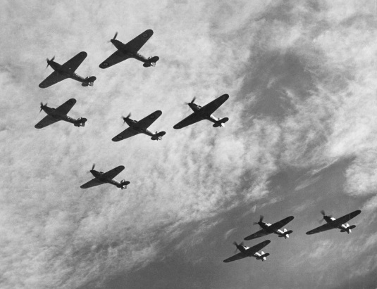
The Battle Of Britain
. The Battle of Britain was a huge plane battle between the royal air force[Britain]and luftwaffer[germany]
.loads of houses were wretched or destroyd in the battle of britian.

