Slide 1
World war 2
Presented by Sam and Matt

Slide 2
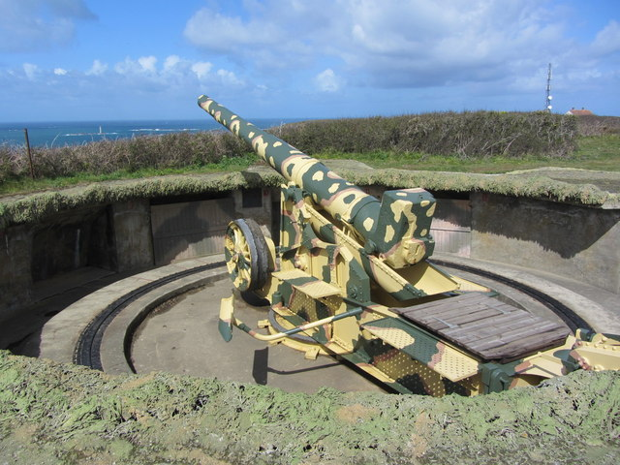
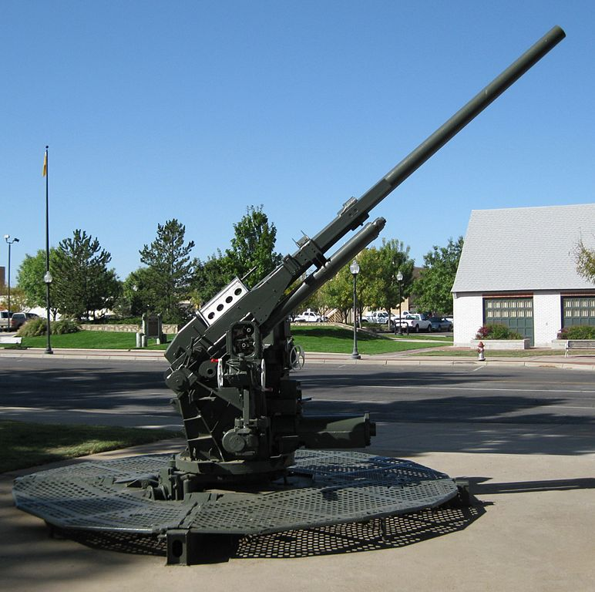
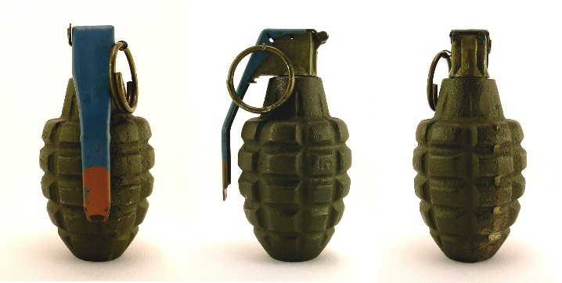
These big guns where called artillery and they did allot of damage. some big guns(artilary)didn’t have a very good effect.

Slide 3
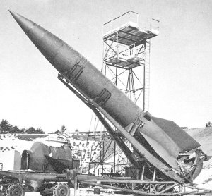
ADOLF HITLER
Adolf hitler started the war and declared war on Poland.he lead the germans ,he was a really bad person .
He commited suicide on the 30th of april wich was his birthday and no one has ever found his body.
He lost the war and loads of countries declared war on him so he knew he was going to die so he
Killed himself.

Slide 4
In world war 2 all of the children had to get sent away unfortunately because it was too dangerous for the children the proper word for sent away in the war was evacuation that’s what we call it now if there was babies they would stay with there guidians.it was very sad and the parents didn’t like it just like the children.

Slide 5
All about planes in ww2
There was loads of planes in ww2 .there was a hurricain spitfire wich used bullets and killed loads of people in the german planes.there was also a hinekal wich dropped bobms aswell as the german planes .those are some of the planes but there were way more these planes were used in the war and the blitz.

Slide 6
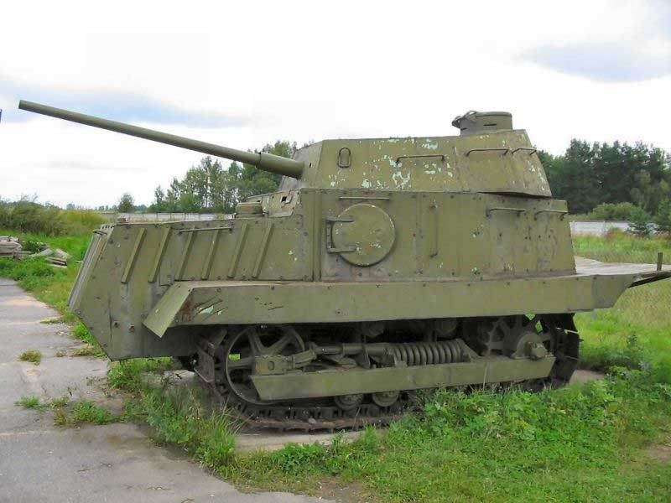
TANKS
Tanks where explosive and they fired massive rounds

Slide 7
Battle of britan
The battle of britian was one of
The main parts of ww2.all the
Battle was in the air.one of the
Battles was called a dog fight
Because when dogs fight its
Quite vicous. Loads of people
Died and some drowned and
Got burnt to death sadly.

