Slide 1
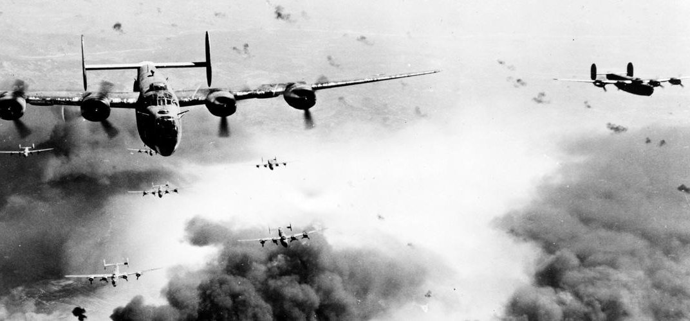
Worl
World War 2
World war 2
Presented by Hayden and Lauren
B
BY HAYDEN AND LAUREN

Slide 2
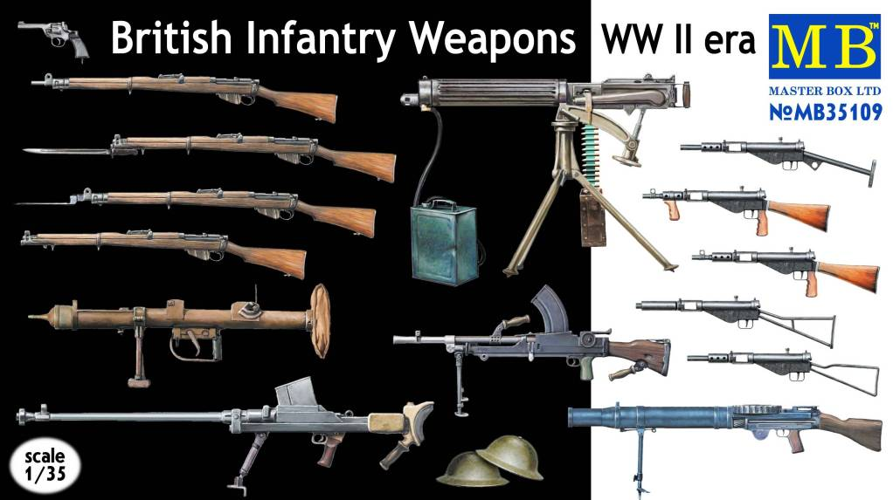
These are
guns and
weapons
from ww2.
They were used for all attacks on all troops and they were probably really heavy

Slide 3
Evacuation in ww2
It was very hard for the evacuees to go away from their family and travel to the countryside to look for new carers to look after them instead of their real parents.
They would have to go on a train to a place where they my have never been before as well as probably most of the older children knowing that the war was going on.
They would have to be really scared to go because they don’t know who there going with

Slide 4
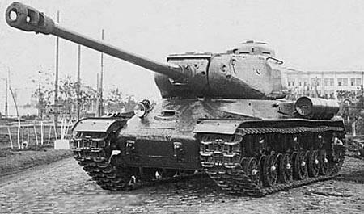
TANKS
Tanks from world war 2 where used on all attacks because
Click hear to watch a top 10 tanks video

