Slide 1
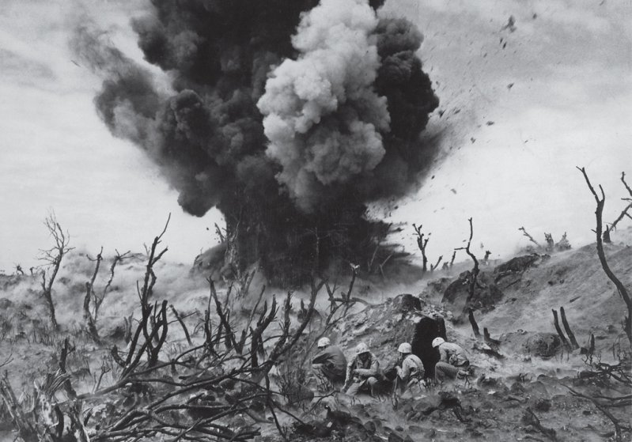
World War 2
Presented by Sophie and Millie G
The war

Slide 2
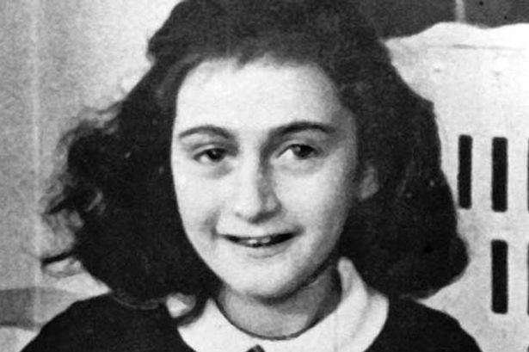
Anne Frank
ww2
ADOLF HITLER
Hitler was born in 20th April 1889 in Braunau.Hewas the leader of the Nazis, and killed millions of jews.
Anne Frank was a little jewish girl that hid in her loft for 3 years.I

Slide 3
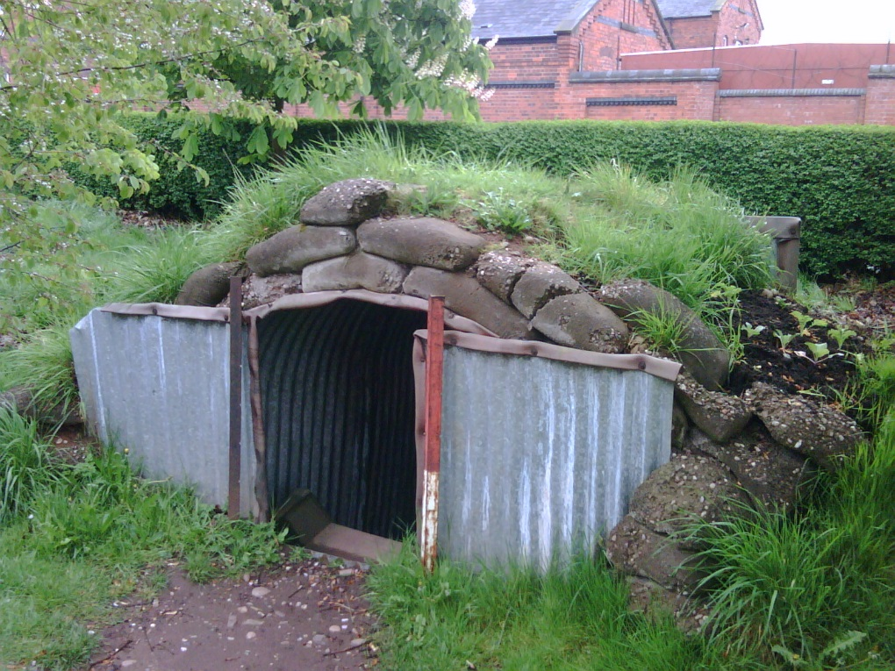
AIR RAID SHELTERS!
Air raid shelters were for when the bombing happened you would go into it to be safe. You would cover it with grass and mud .

